Slide 1
Dashboards

Slide 2
Importance
Dashboards enable you to focus on what is important in your environment.
The VCF Operations console provides a set of predefined dashboards. You can also create custom dashboards to meet the business needs of your users: virtual infrastructure team, executives, application owners, operators, and so on.
You must know how to use dashboards, widgets, and interactions to provide meaningful data and insights to support your day-to-day environment monitoring and optimization.

Slide 3
Module Lessons
Dashboards and Widgets
Managing Dashboards

Slide 4
Dashboards and Widgets

Slide 5
Learner Objectives
Describe the functions of dashboards
Build a custom dashboard
Configure widget interactions
Use metric configuration files

Slide 6
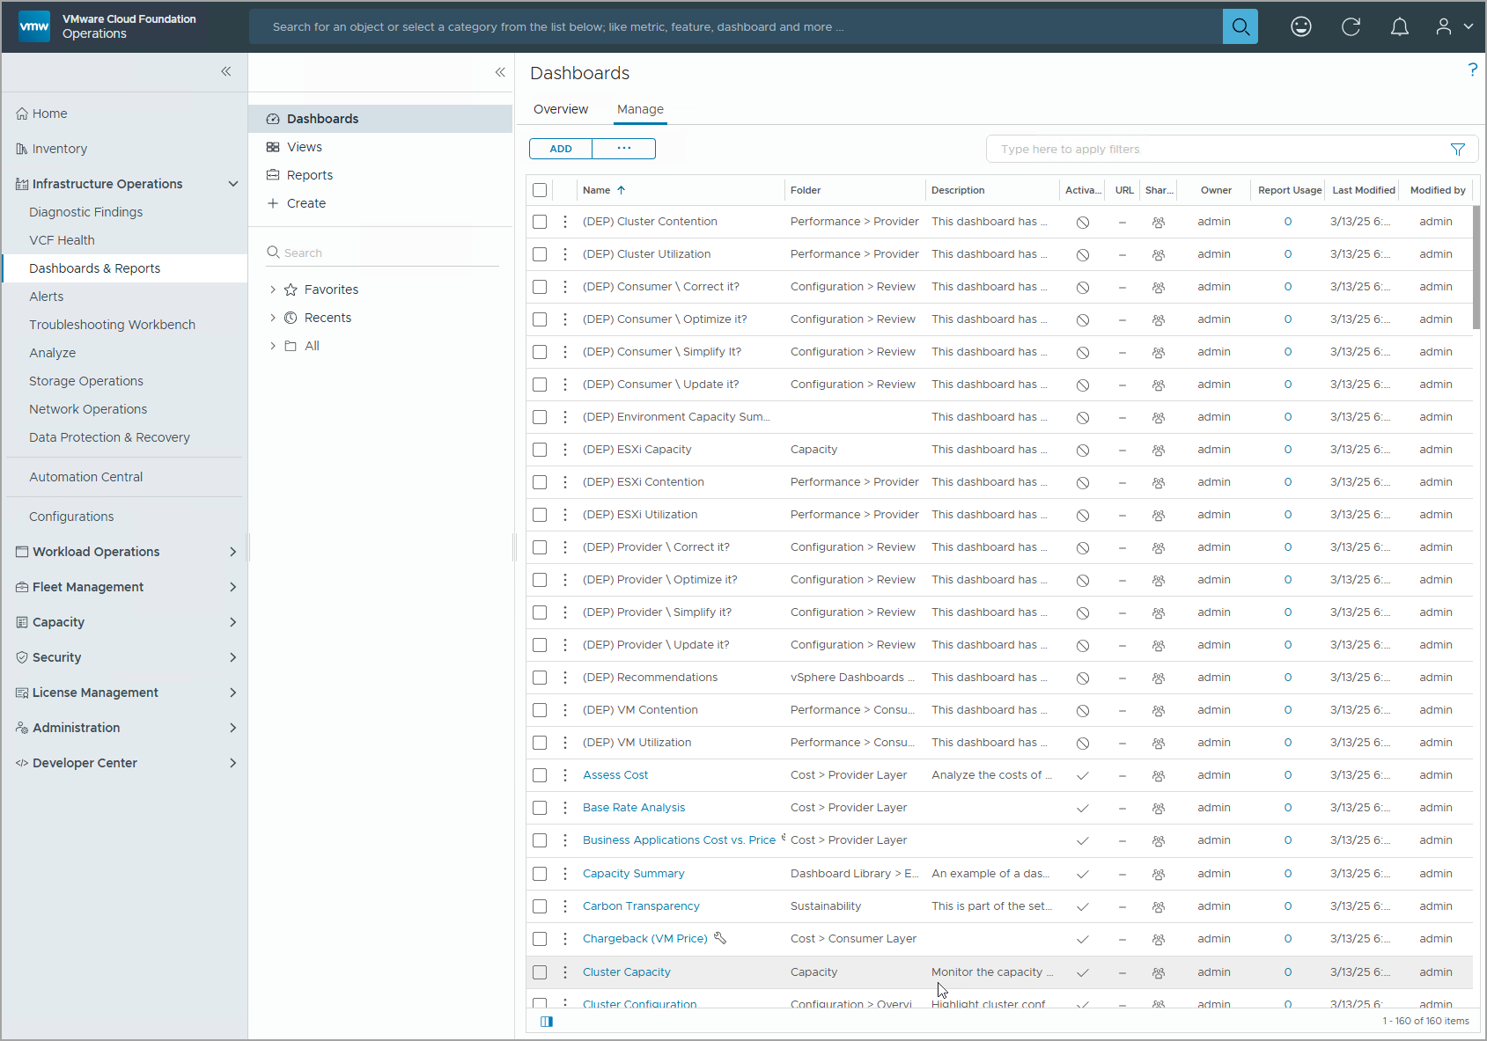
Understanding Dashboards
Dashboards present a visual overview of the performance and state of objects in your virtual infrastructure. To access dashboards, you must navigate to Infrastructure Operations > Dashboards & Reports > Dashboards.
You can view the predefined dashboards on the Overview tab, and view all dashboards (predefined and custom) on the Manage tab. The Manage tab also enables you to manage and alter any dashboards.
Notes:
TalkTrack:
Dashboards offer a visual overview of performance and object status within the virtual infrastructure. Accessing dashboards involves navigating through Infrastructure Operations, then Dashboards & Reports, and finally selecting Dashboards. Predefined dashboards are visible under the Overview tab. Both predefined and custom dashboards appear under the Manage tab. The Manage tab also allows for the management and alteration of dashboards.
<End>

Slide 7
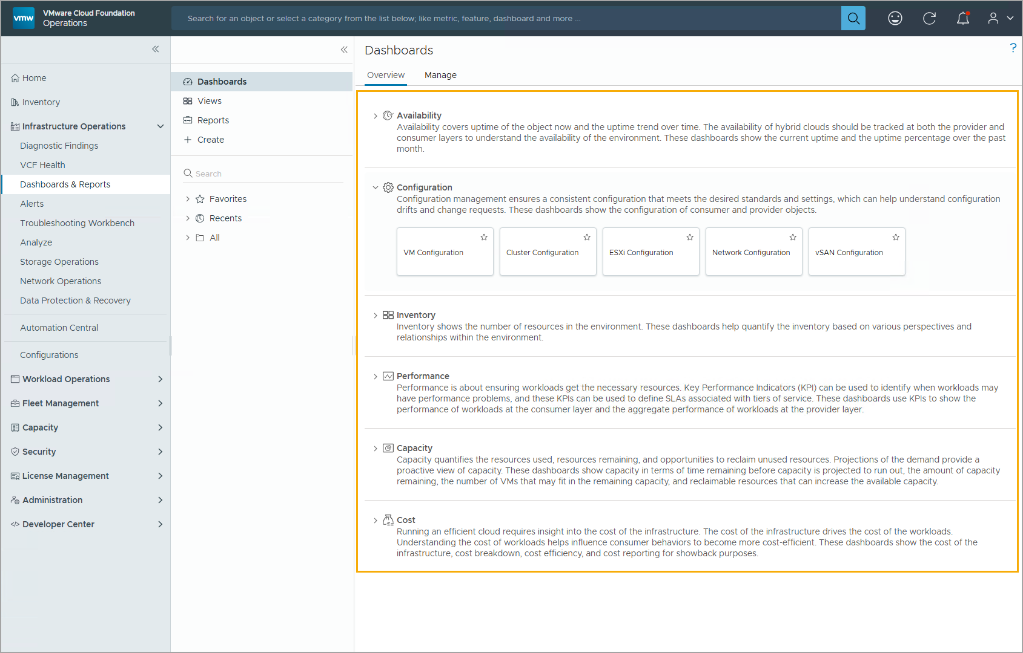
Understanding Predefined Dashboards
You can access some of the useful, predefined dashboards from the Dashboards > Overview home page.
The predefined dashboards are categorized as follows: Availability, Configuration, Inventory, Performance, Capacity, and Cost.
To access any predefined dashboard, expand the selected category and click the specific dashboard.
Notes:
TalkTrack:
Predefined dashboards are accessible from the Dashboards Overview home page. These dashboards are categorized to facilitate organization and discovery. Categories include Availability, Configuration, Inventory, Performance, Capacity, and Cost. To access a specific predefined dashboard, one expands the relevant category and then clicks on the desired dashboard. For instance, clicking on Configuration provides access to dashboards related to ESXi Configuration.
<End>
For example, in this screenshot, you can click Configuration to access dashboards related to ESXi Configuration.

Slide 8
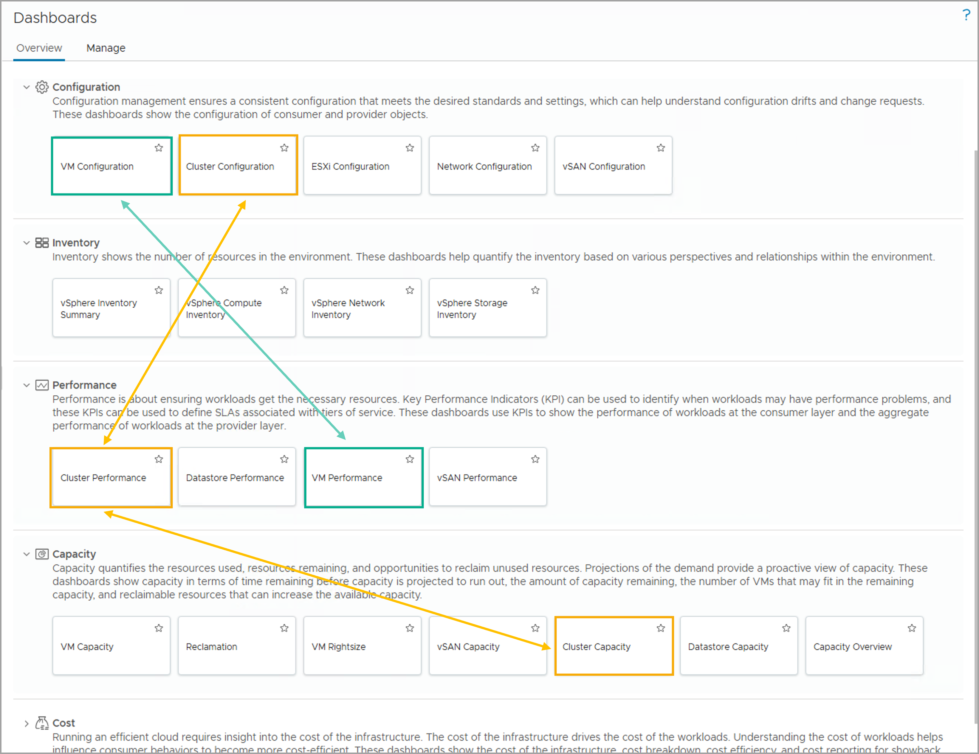
Predefined Dashboard Use Cases
The predefined dashboards in your VCF Operations console cover a great range of use cases to help you understand and manage your virtual environment. Dashboards are powerful proactive tools that help you monitor your environment or troubleshoot any issue.
The following examples show how you can leverage some of the predefined dashboards:
If you want to understand the status of the clusters in your virtual environment and want to know how many more VMs you can fit into any existing cluster, you can use the combination of Cluster Capacity, Cluster Configuration, and Cluster Performance to help you.
If you want to understand the performance of your VMs and compare VM configurations to understand the performance difference, you can use a combination of VM Configuration and VM Performance to help you understand the VMs in your virtual environment.
Notes:
TalkTrack:
Predefined dashboards in VCF Operations cover a wide range of data and metrics for virtual environments. These dashboards serve as a proactive tool for environmental monitoring and troubleshooting. Two examples demonstrate how to leverage these predefined dashboards. First, to understand cluster status and VM capacity, combine Cluster Capacity, Cluster Configuration, and Cluster Performance dashboards. Second, for analyzing VM performance and comparing configurations, use a combination of VM Configuration and VM Performance dashboards.
<End>

Slide 9
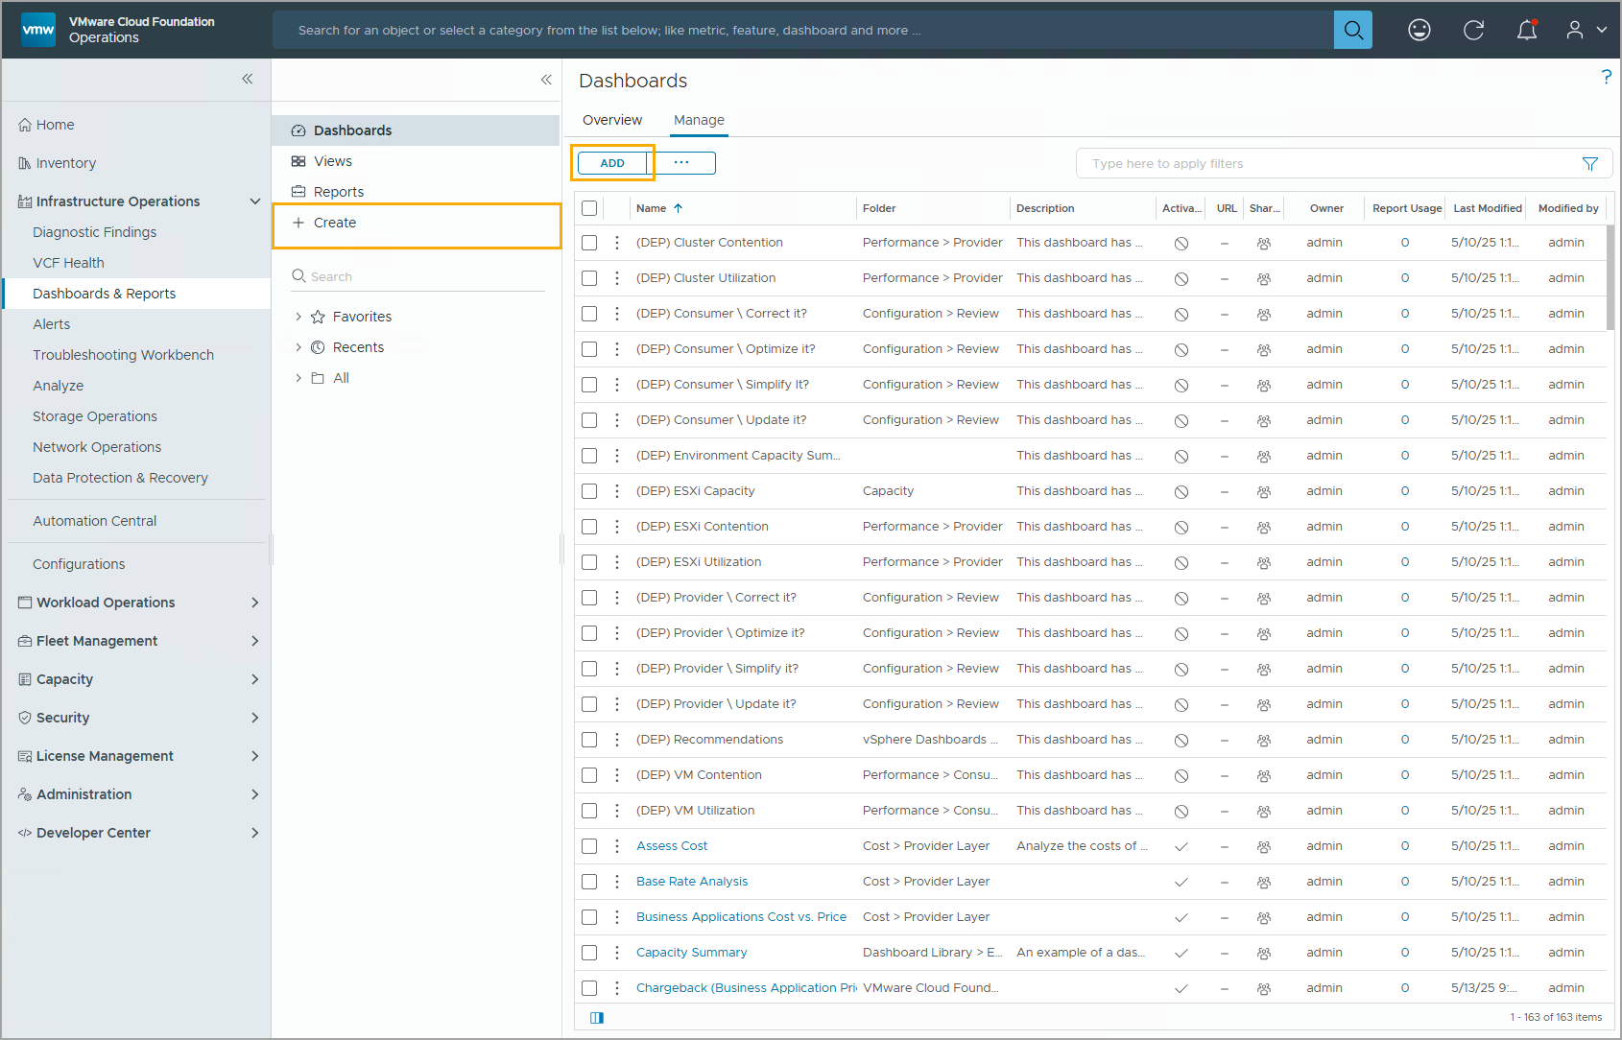
Understanding Custom Dashboards
If the predefined dashboards cannot meet your organization's business case, you can create custom dashboards to meet your environment needs.
To create a custom dashboard, you can either click + Create or click ADD on the Manage tab.
Creating a custom dashboard requires the completion of the following tasks:
Adding dashboard widgets
Configuring widget data sources and objects
Configuring widget interactions
Notes:
TalkTrack:
When predefined dashboards do not meet specific organizational requirements, custom dashboards can be created. To initiate the creation of a custom dashboard, click either the plus Create button or the ADD button located under the Manage tab. The creation of a custom dashboard involves completing three key tasks. First, add dashboard widgets. Second, configure the data sources and objects for each widget. Third, set up the interactions between widgets.
<End>

Slide 10
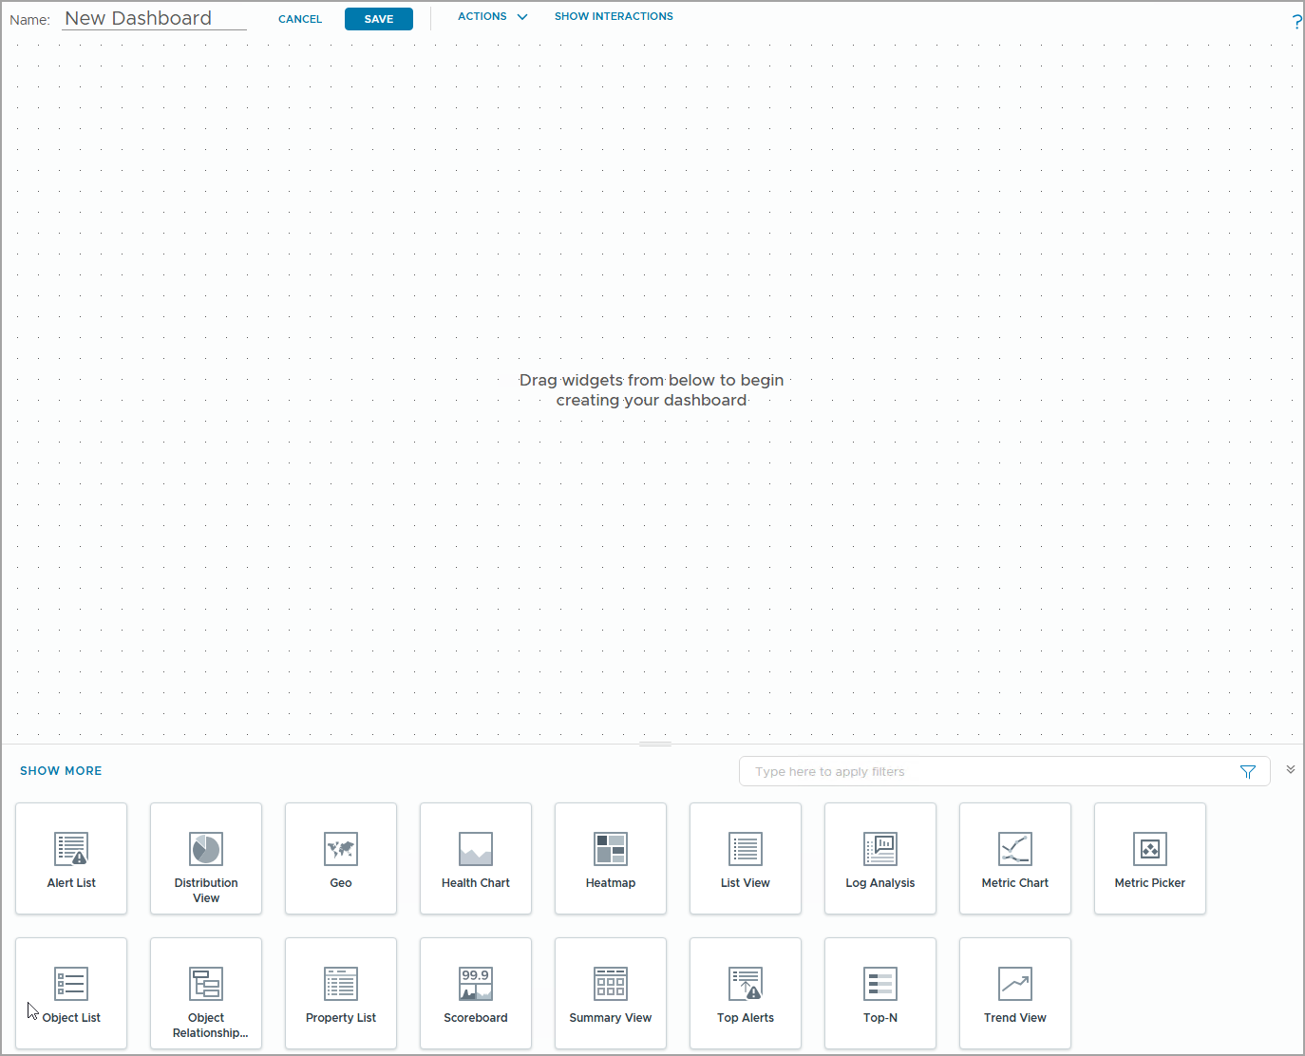
Designing a Dashboard
When creating a custom dashboard, you must consider its purpose, audience, and required data:
Identify the audience, or consumers, of the dashboard.
Define the purpose of the dashboard and how it should be used.
Define the functional aspects of the dashboard (operations, forensics, and support).
Identify the data sources.
Identify the necessary widgets and interactions.
Build a prototype dashboard.
Share the dashboard with the intended audience.
Notes:
TalkTrack:
Designing a dashboard requires careful consideration of its purpose, audience, and necessary data. Identify the target audience or consumers of the dashboard. Define the dashboard's purpose and its intended use. Outline the functional aspects for operations, forensics, or support. Pinpoint all relevant data sources. Determine the essential widgets and their interactions. Construct a prototype dashboard for review. Finally, share the dashboard with the intended audience. Different audiences have varying needs, for example, executives seek high-level overviews, while administrators require detailed infrastructure data. Identifying relevant data sources is crucial, and adding additional data, such as super metrics, may be necessary for monitoring correct metrics.
<End>
When designing a dashboard, you must consider how you want to use the dashboard. Different audiences have different needs. For example, executives want a high-level overview of the performance of the virtual infrastructure and administrators want details and fast access to infrastructure data. You identify relevant data sources. You might need to create additional data, such as super metrics. You might also want to add a management pack to monitor the correct metrics.

Slide 11
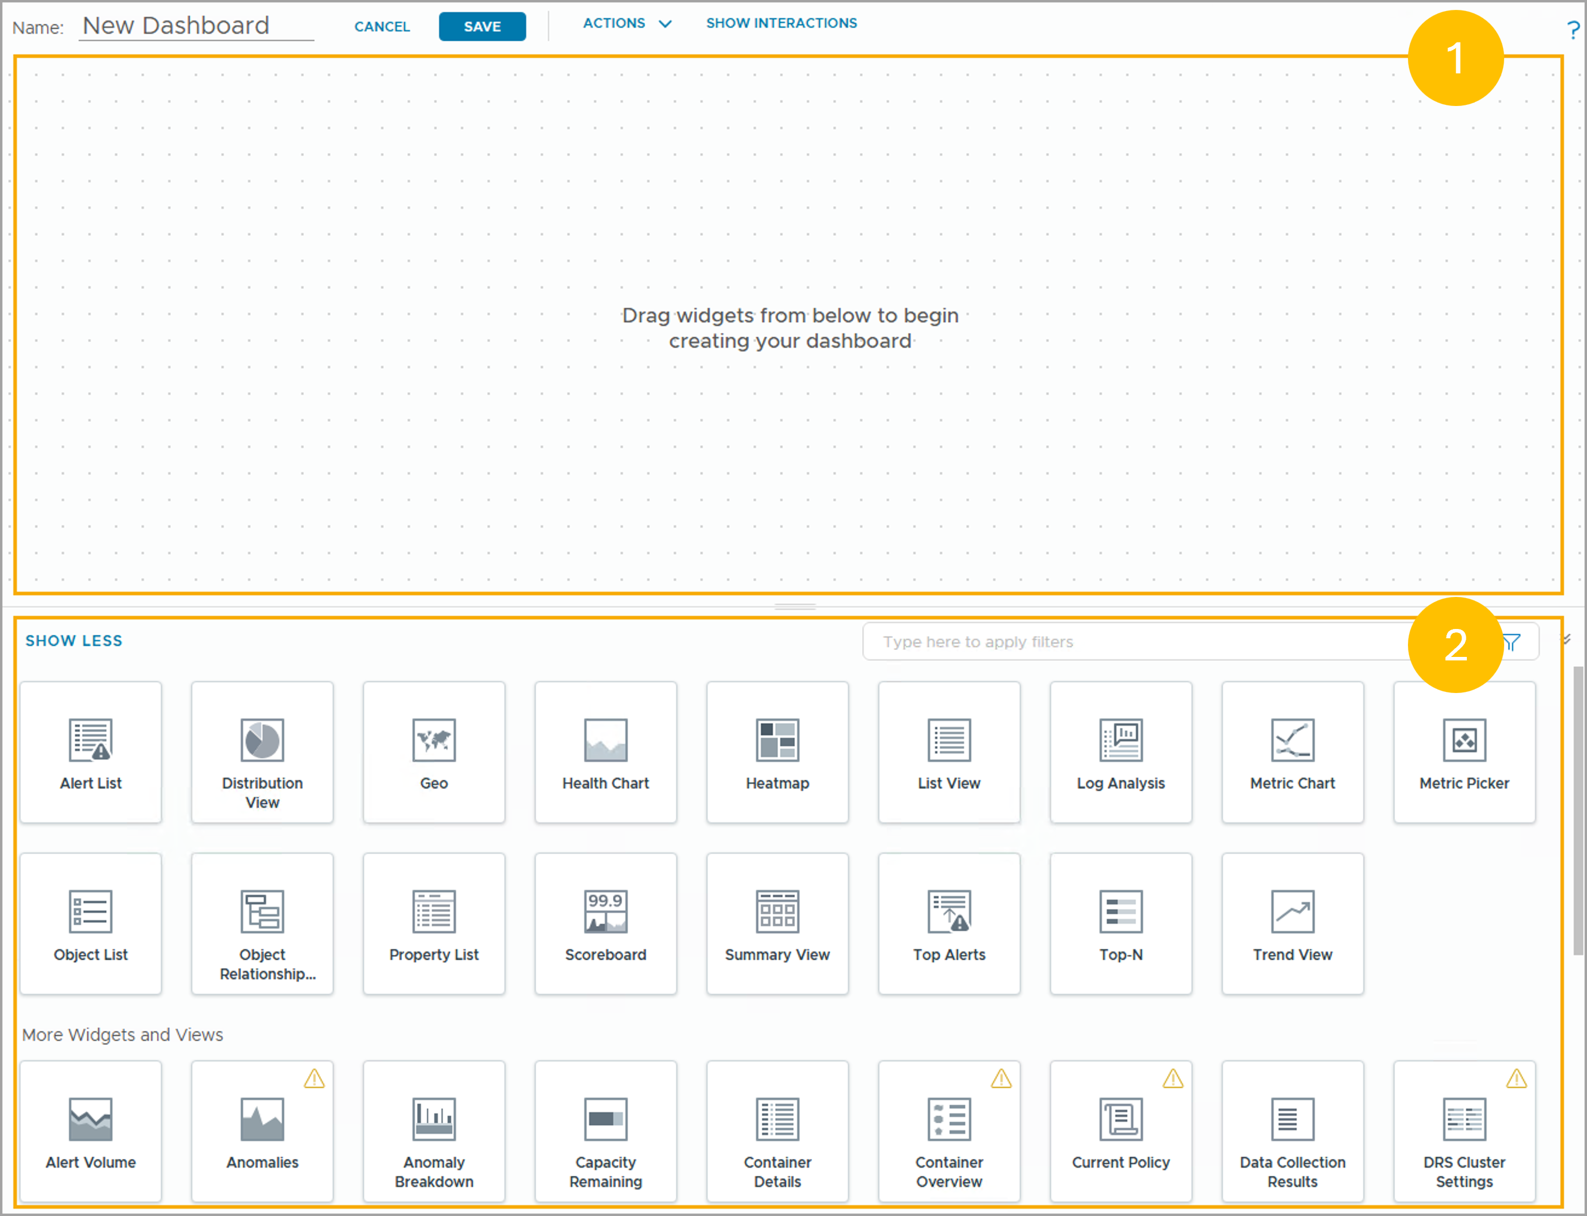
Understanding the Dashboard Creation Wizard
The dashboard creation wizard has two main areas:
Dashboard canvas: Displays the data from widgets. You can customize the layout of added widgets.
Widget and View selection board: Enables you to choose elements to add to the dashboard canvas. You can choose from widgets and views.
Notes:
TalkTrack:
The dashboard creation wizard has two primary areas. The dashboard canvas is where data from widgets is displayed, allowing for layout customization of added widgets. The widget and view selection board provides elements for adding to the dashboard canvas. One can choose from available widgets and views here.
<End>

Slide 12
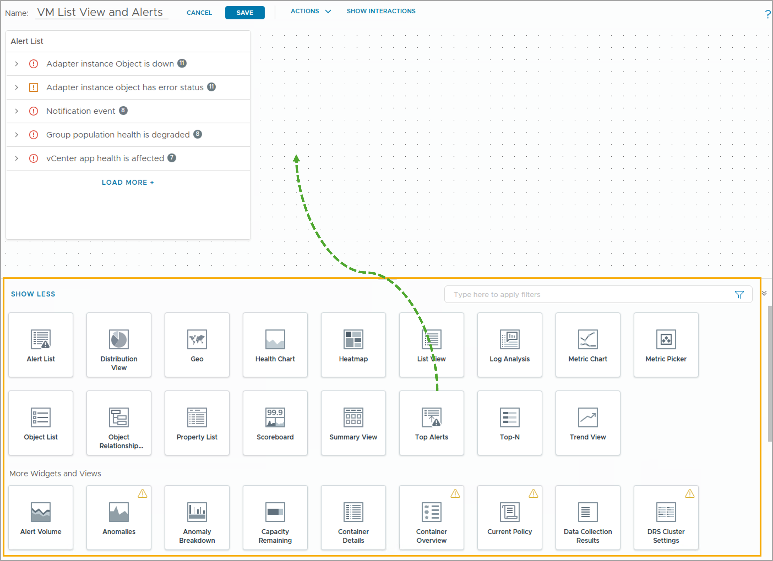
Adding the Dashboard Elements
The widgets list panel displays a list of predefined VCF Operations widgets or views that are commonly used.
You position the dashboard elements (views and widgets) by dragging them to the design canvas.
When you drag the widget or view to the desired location in the layout, the existing elements are automatically rearranged. You can reposition any existing elements that have moved when new views or widgets are added.
Notes:
TalkTrack:
The widgets list panel displays commonly used predefined VCF Operations widgets or views. Dashboard elements, including views and widgets, are positioned by dragging them onto the design canvas. When a widget or view is dragged to a desired location, existing elements automatically rearrange. Repositioning elements after new additions is possible. A dashboard can be created by adding widgets, views, or a combination of both. VCF Operations offers a selection of widgets and views for monitoring specific metrics and properties of objects. To resize a widget or view, drag its bottom-right corner. To reposition a widget, click its name and drag it to the desired spot on the dashboard canvas. In the example provided, the Alert List widget is already present on the dashboard canvas, and the Top Alerts widget is being added.
<End>
You can create a dashboard by adding widgets or views or both. VCF Operations provides a list of widgets or views that you can add to your dashboard to monitor specific metrics and properties of objects in your environment.
To resize a widget or a view, drag the bottom-right corner of the widget or the view. To reposition a widget, click the widget name and drag it to the desired place on the dashboard canvas.
In this example, the Alert List widget is already on dashboard canvas, and the Top Alerts widget is about to be added to the dashboard canvas.

Slide 13
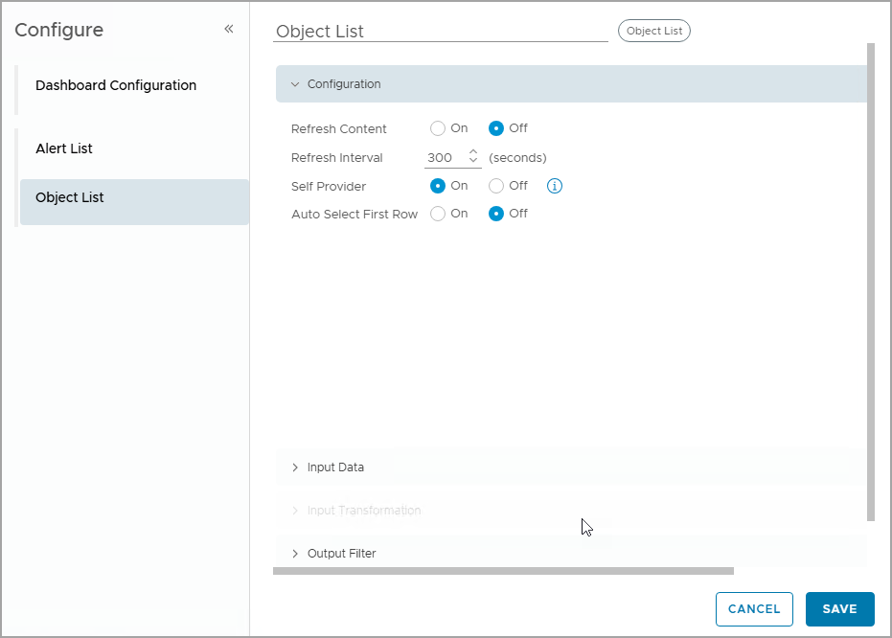
Common Widget Configuration Options
Click the Edit icon to configure the widget or view.
A widget uses one or more common configuration options:
Title: A custom title that distinguishes this instance from other instances of this widget.
Refresh Content: Enables or disables the automatic refreshing of the data in the widget display.
Refresh Interval: Specifies how often to refresh the data in the widget display if you enable Refresh Content.
Self Provider: Indicates whether objects for which data appears in the widget are defined in the widget or are provided by another widget.
Notes:
TalkTrack:
Configuring a widget or view begins by clicking the Edit icon. Widgets utilize common configuration options. A custom title distinguishes one widget instance from others. Refresh Content enables or disables automatic data refreshing in the widget display. The Refresh Interval specifies how frequently data refreshes if Refresh Content is active. Self Provider indicates if the data objects for the widget are internally defined or supplied by another widget. Most widgets require individual configuration to display information. When Refresh Content is not enabled, the widget updates only when the dashboard is opened or when Refresh on the dashboard widget is clicked. The Object List widget in the example does not depend on other widgets for its object data.
<End>
Most widgets include options that must be configured individually to display information. If Refresh Content is not enabled, the widget is updated only when the dashboard is opened or when you click Refresh on the widget in the dashboard. In the example, the Object List widget does not rely on any other widget for object data.

Slide 14
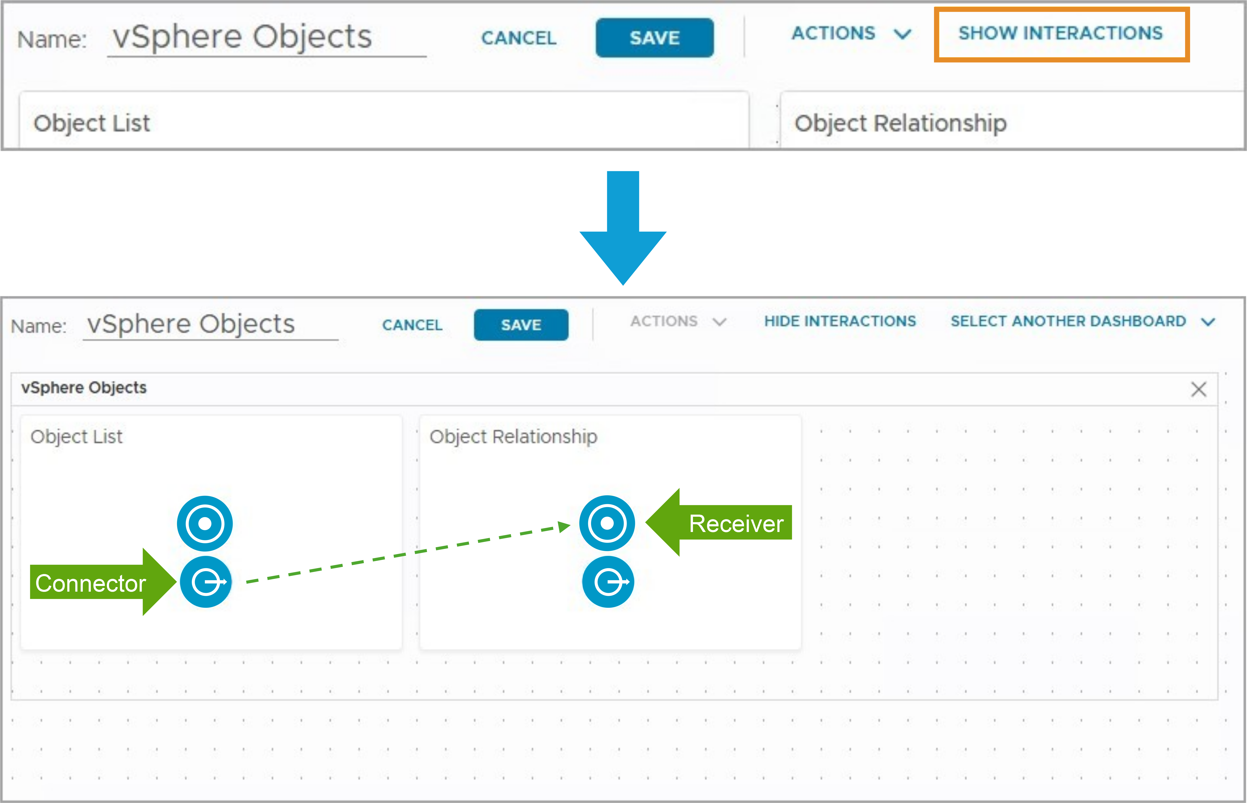
Understanding Widget Interactions
A widget interaction is a configured relationship between two widgets, where one widget provides data to a receiving widget. On the receiving widget, you must set Self Provider to Off to use interactions.
You must understand the Connector and Receiver concepts:
Connector (Outgoing Object Interaction): Widget that provides data to the receiving widget.
Receiver (Incoming Object Interaction): Widget that receives data from a data source widget.
Click Show Interactions to pair the connector icon with the receiver icon.
Drag the pointer from the connector to the receiver.
Notes:
TalkTrack:
Widget interactions are fundamental to creating dynamic and informative dashboards. They establish a flow of information between different components. An interaction involves two key roles, a connector and a receiver. The connector is the source, sending out data. The receiver is the destination, taking in that data. To enable an interaction, it is crucial to adjust a setting on the receiving widget. Set its self provider option to off. Once the receiver is configured, initiate the connection process. Locate the show interactions option on the providing widget. Then, drag the connector icon from the providing widget. Drop it onto the receiver icon of the intended receiving widget. This action establishes the link. Consider a practical application. An object list, acting as the connector, can filter or drive the display of an object relationship, which serves as the receiver. This connection transforms static information into an interactive experience.
<End>
Connection icons enable you to create interactions between widgets and views on the dashboard canvas. To use interactions between widgets, on the receiving widget, the Self Provider setting must be set to Off.
In this example, you drag the Connector icon to create an interaction from the Object List widget to the Receiver icon in the Object Relationship widget.

Slide 15
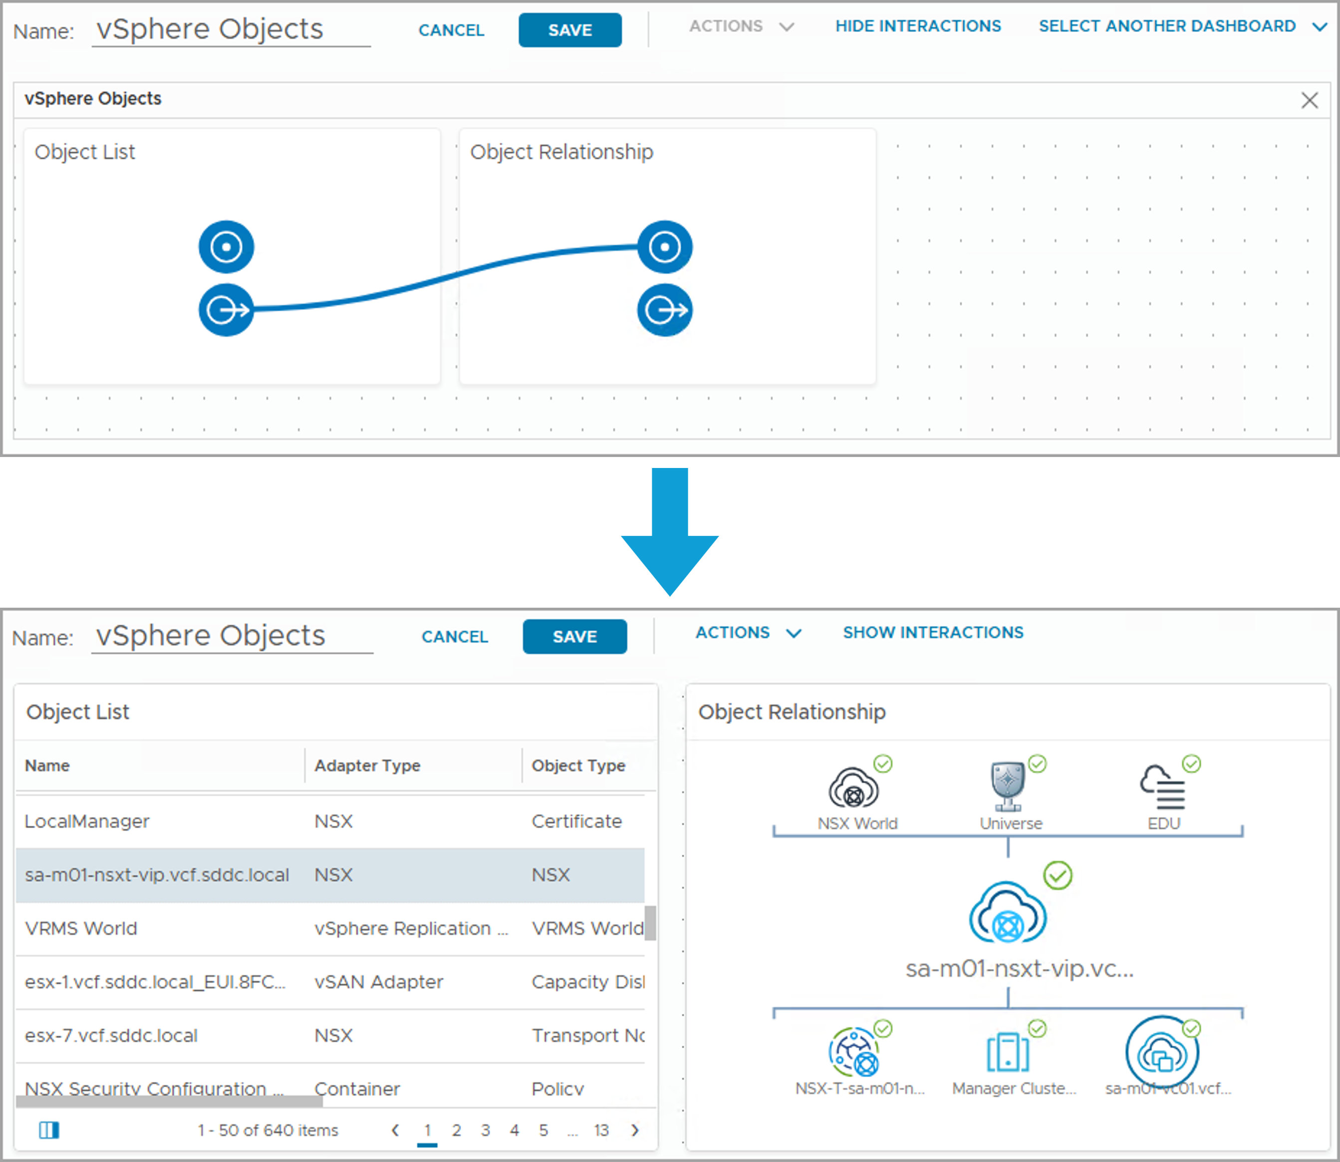
Example Widget Interactions
Widget interactions are indicated by a line between the connector and receiver icons.
Click Hide Interactions to return to the design canvas.
You can test the interaction from the design canvas.
Notes:
TalkTrack:
Interactions are visibly represented. A line connects the connector icon to the receiver icon, illustrating the data flow. After setting up an interaction, it is possible to exit the interaction view. Simply select the hide interactions option. This returns the user to the standard design canvas. Testing the interaction happens directly on the design canvas. There is no need to switch modes or views. Consider an object list acting as a data provider. When an item is selected from that list, its corresponding parent-child relationships automatically appear in an object relationship widget, which is the data receiver. This dynamic connection is visually confirmed by a blue line. It signifies that the object list is indeed supplying information to the object relationship widget. This direct link allows for immediate verification of the interaction's functionality.
<End>
Selecting any of the objects in the Object List widget displays its parent-child relationships in the Object Relationship widget. The blue line shows that the Object List widget provides information to the Object Relationship widget. You can test the widget interaction from the design canvas. In the example, when you select an object from the Object List widget, the related information appears in the Object Relationship widget.

Slide 16
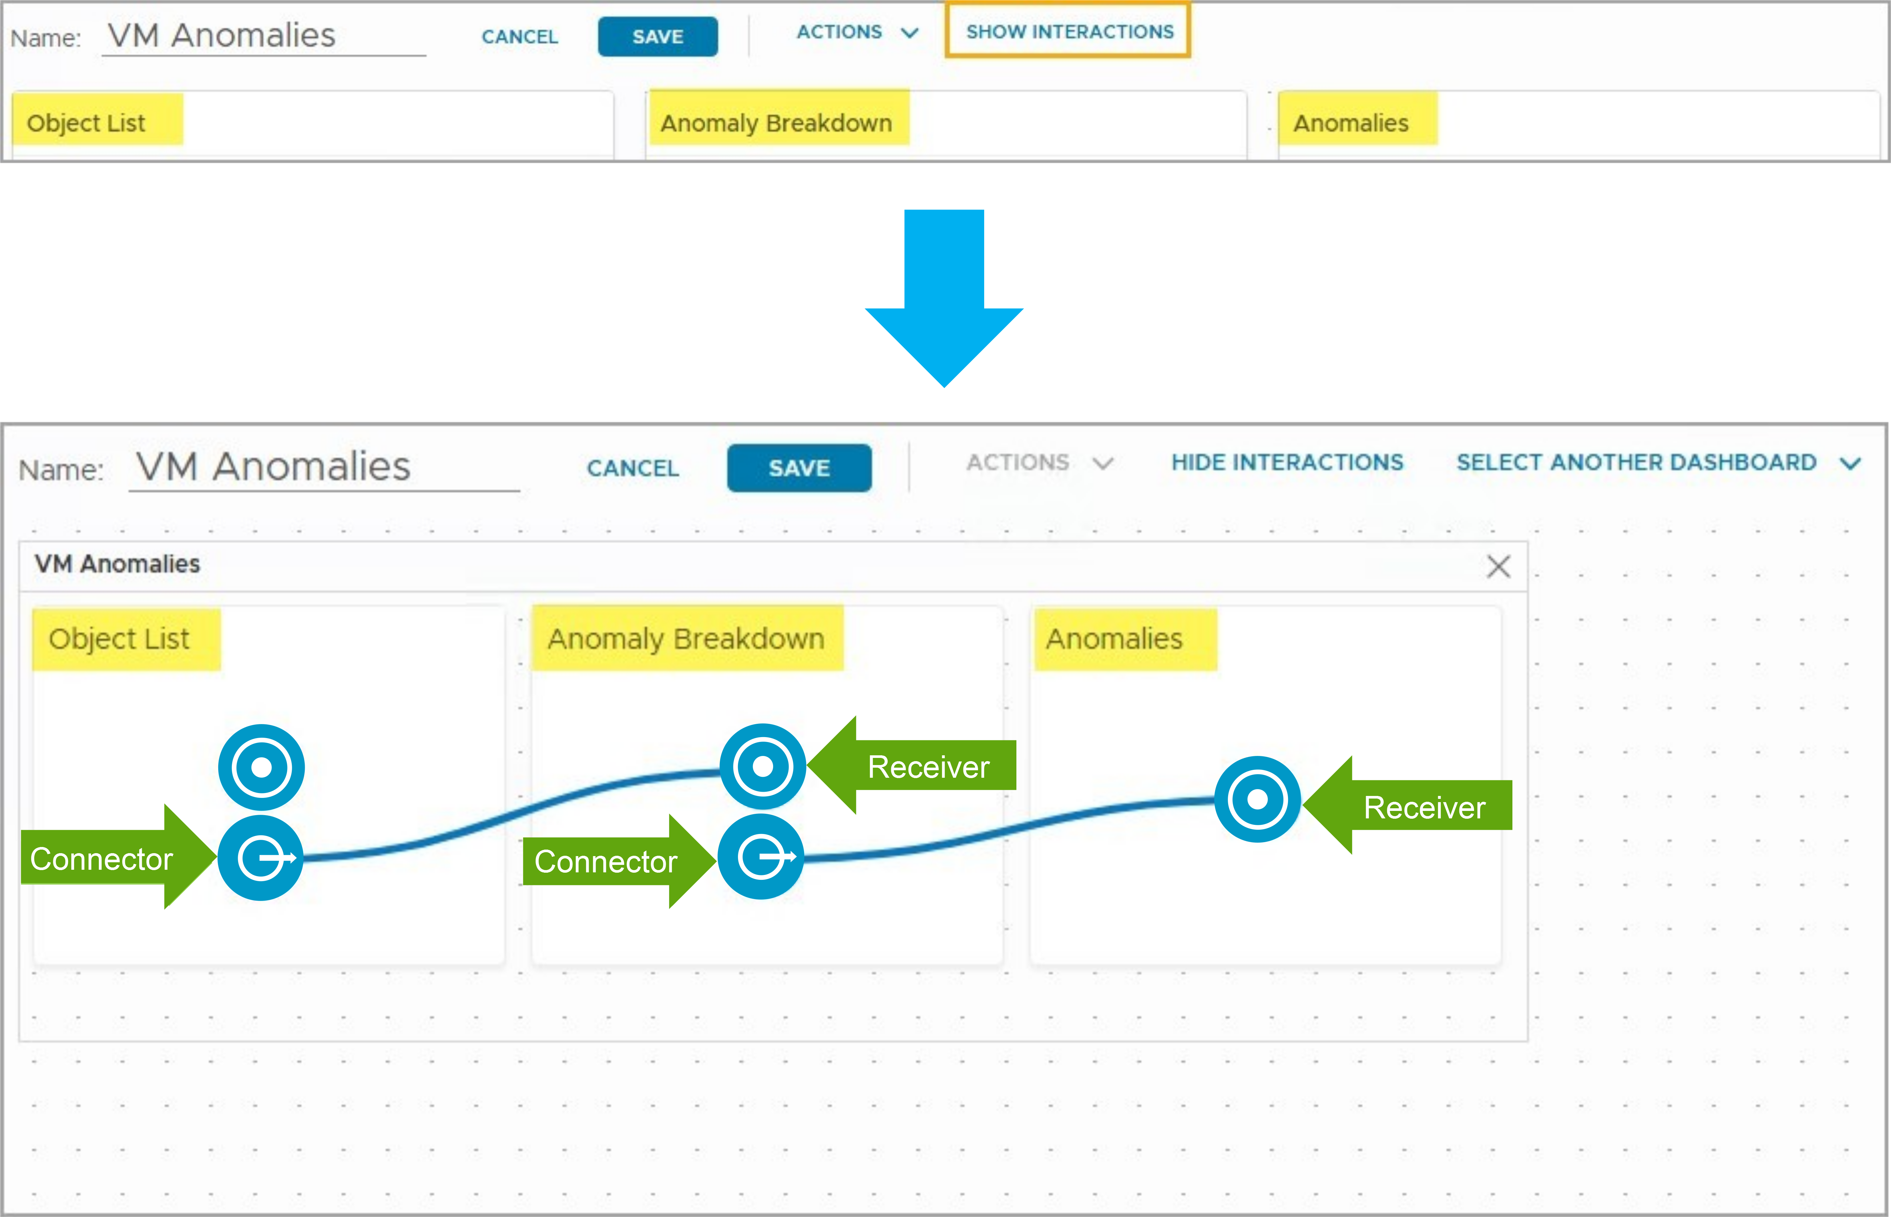
Multiple Widget Interactions
Widgets can be providers or receivers, or both, for object and metrics data.
You can configure interactions between widgets in the same dashboard or between widgets in different dashboards.
In this example, Object List provides data to the Anomaly Breakdown widget, and Anomaly Breakdown provides data to the Anomalies widget.
Notes:
TalkTrack:
Widgets are versatile. They can act as data providers, data receivers, or even both simultaneously. This applies to both object and metrics data. It is possible to configure interactions not only between widgets on the same dashboard but also between widgets residing on different dashboards. This capability allows for complex, interconnected data presentations. Consider an example demonstrating this flexibility. An object list provides data to an anomaly breakdown widget. In turn, that anomaly breakdown widget then provides data to a third widget, anomalies. This creates a chain of interactions. Some widgets are designed to handle multiple incoming data streams. They can receive information from more than one provider. Conversely, a single widget can also send its data to several different receiving widgets. The specific capabilities for interactions depend on the type of widget in question. Widget interactions are configured based on their inherent functionalities.
<End>
Some widgets can have more than one provider or provide data to multiple widgets. You can add multiple widgets. Based on the widget type, you can set the widget interactions.

Slide 17
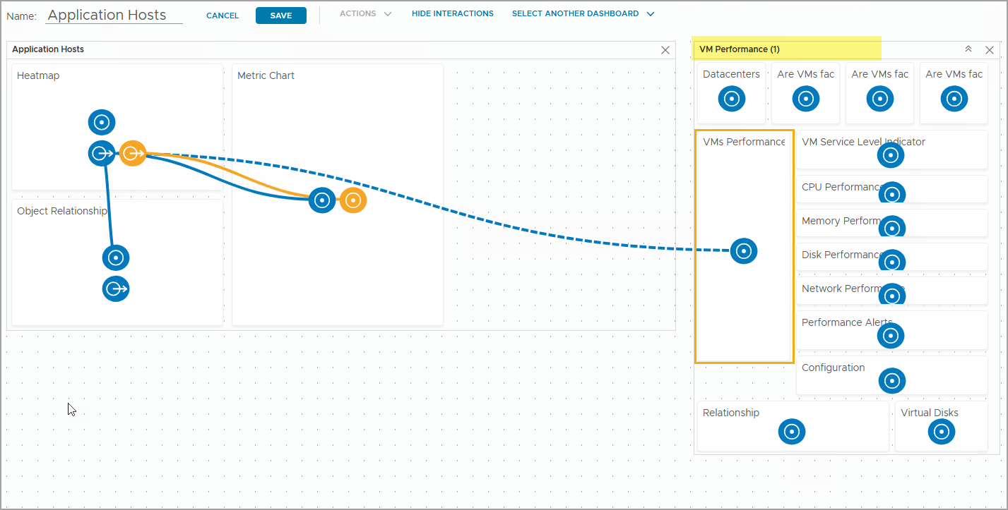
Configuring Interactions between Dashboards
You can configure interactions between widgets in different dashboards.
Click Select Another Dashboard and select another dashboard to create a connection with a widget in the other dashboard. After you select the other dashboard, you configure the interaction with the widget as if the widgets were in the same dashboard. In the example, the object data from the Heatmap widget is sent to the VMs Performance widget in the VM Performance dashboard.
Notes:
TalkTrack:
It is possible to configure interactions not just within a single dashboard, but also between widgets on entirely different dashboards. This expands the scope of data analysis considerably. To initiate a cross-dashboard connection, select the "Select Another Dashboard" option. This allows the user to choose the target dashboard for the interaction. Once the other dashboard is selected, the process for configuring the interaction remains the same as if the widgets were on the same dashboard. The established method for connecting providers and receivers still applies. Consider an illustrative scenario. Data originating from a heatmap widget could be sent to a virtual machines performance widget located on a separate "VM Performance" dashboard. This demonstrates how data can seamlessly flow across dashboard boundaries. Establishing connections between widgets, whether on the same dashboard or across different ones, significantly enhances problem investigation and the analytical depth of available information. A single dashboard can support up to 25 widget interactions.
<End>
Connecting a widget to widgets on the same dashboard or to widgets on a different dashboard can help you investigate problems and improve the analysis of the provided information. You can create up to 25 widget interactions in a dashboard.

Slide 18
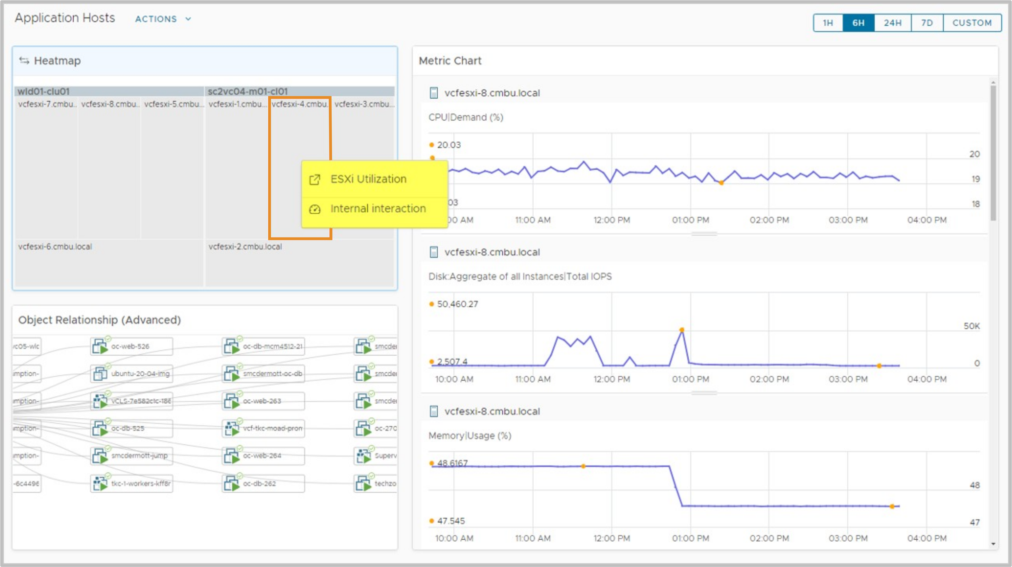
Navigating between Dashboards
When you have configured between-dashboard interactions, you can navigate between the connecting dashboards by clicking the interacting widgets.
To view widget interactions from a dashboard, click an object from a provider widget that has widget interactions defined. A window appears with a link to the external dashboard if it is configured.
In this example, you can click ESXi Utilization to open that dashboard for the ESX host system you selected.
Notes:
TalkTrack:
Once cross-dashboard interactions are configured, it is possible to seamlessly move between the linked dashboards. This is achieved by interacting directly with the widgets involved in the connection. To observe these widget interactions from a dashboard, select an object within a provider widget that has defined interactions. A new window will appear, containing a link to the external dashboard, if one is configured. As an illustration, one could click on "ESXi Utilization". This action would directly open the dashboard specifically designed for the ESX host system that was selected. This provides a quick and efficient way to drill down into related data on another dashboard. The ability to navigate directly between dashboards based on these interactions significantly streamlines the process of investigating data and gaining deeper insights. It allows for a more fluid and integrated analytical workflow.
<End>
In the example, click ESXi Utilization to open that dashboard for the ESX host system you selected.

Slide 19
Custom Dashboard Use Cases
A custom dashboard enables you to add more granular criteria into your dashboard to display exactly the data you want to see.
For example, assume you need to move VMs from one cluster to another, and want to understand the cluster capacity for this type of operation. Instead of using the combination of Cluster Capacity, Cluster Configuration, and Cluster Performance, you can create one single custom dashboard. The custom dashboard can contain the following widgets:
A list of clusters with their important capacity properties and metrics.
A list of ESX hosts from each cluster.
A list of VMs with their configuration properties and consumption metrics.
In another example, if you want to compare VM performance for two or more VMs in your virtual environment over time, instead of using the predefined VM Configuration and VM Performance, you can create a custom dashboard with the following widgets:
A list of VMs with their ESX host property and real-time consumption metrics. The list can be configured to support multiple selections so you can select multiple VMs to compare.
A series of performance widgets such as CPU usage trend, Memory usage trend, Disk Read trend, and so on. The performance widgets receive data from the VM list, so they only display the performance metrics for the selected VMs.
Notes:
TalkTrack:
Custom dashboards provide exceptional flexibility. They allow users to add very specific criteria, ensuring the displayed data is precisely what is needed. Consider a scenario where the goal is to understand cluster capacity when moving virtual machines from one cluster to another. Instead of relying on a combination of predefined dashboards for cluster capacity, configuration, and performance, a single custom dashboard can be created. This custom dashboard could include a list of clusters, displaying their key capacity properties and associated metrics. It could also list the ESX hosts from each of those clusters. Furthermore, a list of virtual machines, complete with their configuration properties and consumption metrics, could be incorporated. This consolidates all relevant information into one view. In another instance, if there is a need to compare the performance of two or more virtual machines over time, rather than using separate predefined dashboards for virtual machine configuration and performance, a custom dashboard can be built. This custom dashboard might contain a list of virtual machines, showing their ESX host properties and real-time consumption metrics. This list can be configured to allow for multiple selections, enabling the comparison of several virtual machines simultaneously. Accompanying this, a series of performance widgets could display metrics like CPU usage trend or memory usage trend. These performance widgets would receive their data from the virtual machine list, ensuring they only show metrics for the selected virtual machines.
<End>

Slide 20
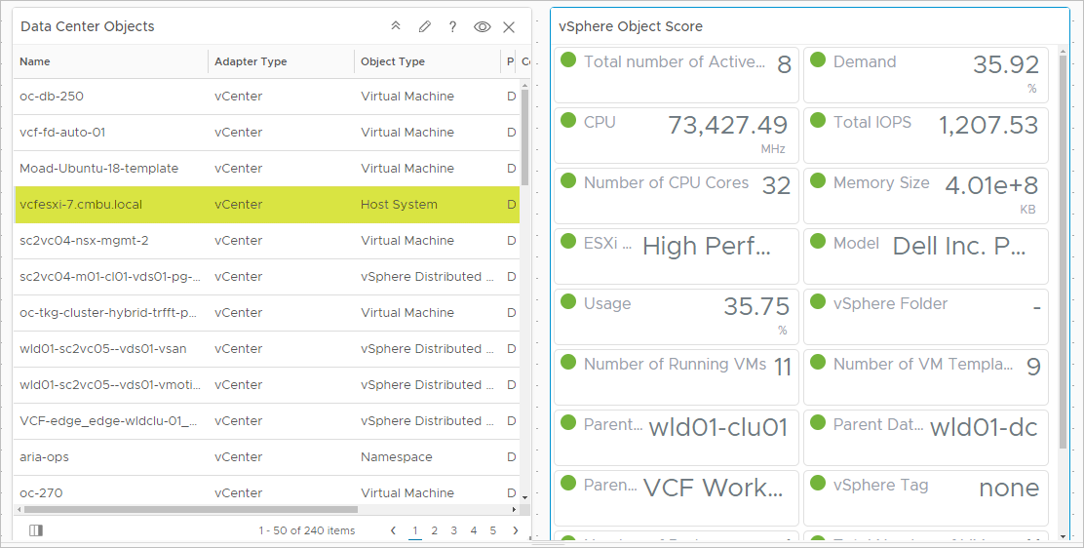
Metric Configuration Files
Metric configuration files can create a custom set of metrics for customizing supported widgets with meaningful data.
Metric configuration files store the metric attribute keys in XML format.
Several widgets support customization using the metric configuration files:
Scoreboard
Metric Chart
Property List
Rolling View Chart
Sparkline Chart
Topology Graph
Notes:
TalkTrack:
Metric configuration files are powerful tools for customization. They allow for the creation of unique sets of metrics, which then provide more meaningful data within supported widgets. These configuration files store the specific metric attribute keys. They are structured in an XML format, ensuring a standardized way to define and manage metric data. Several types of widgets are designed to support customization through these metric configuration files. This includes the scoreboard, the metric chart, and the property list. Additionally, the rolling view chart, sparkline chart, and topology graph can also leverage these files for tailored data presentation. Through the customization offered by metric configuration files, the visualization of metrics can be significantly enhanced. This allows for the presentation of data that directly reflects the specific needs and context of the adapter and object types being monitored. As an important example, consider how host data can be presented in a scoreboard widget. By utilizing a metric configuration file, a predetermined set of metrics, chosen for their relevance to a supported object type, can be displayed. From the metric configuration page, a file (in XML format) can be created that defines these specific metric sets for supported widgets.
<End>
Using the metric configuration file customization, you can manipulate the visualization of the metrics so that you can provide users with more meaningful data. You can configure one or more metric configuration files that define different sets of metrics for the adapter and object types. The supported widgets are populated based on the configured metrics and selected object type. In this example, important host data is presented in the scoreboard widget vSphere Object Score. From the Metric Configuration page, you create an XML file that displays a predefined set of metrics in a supported widget.

Slide 21
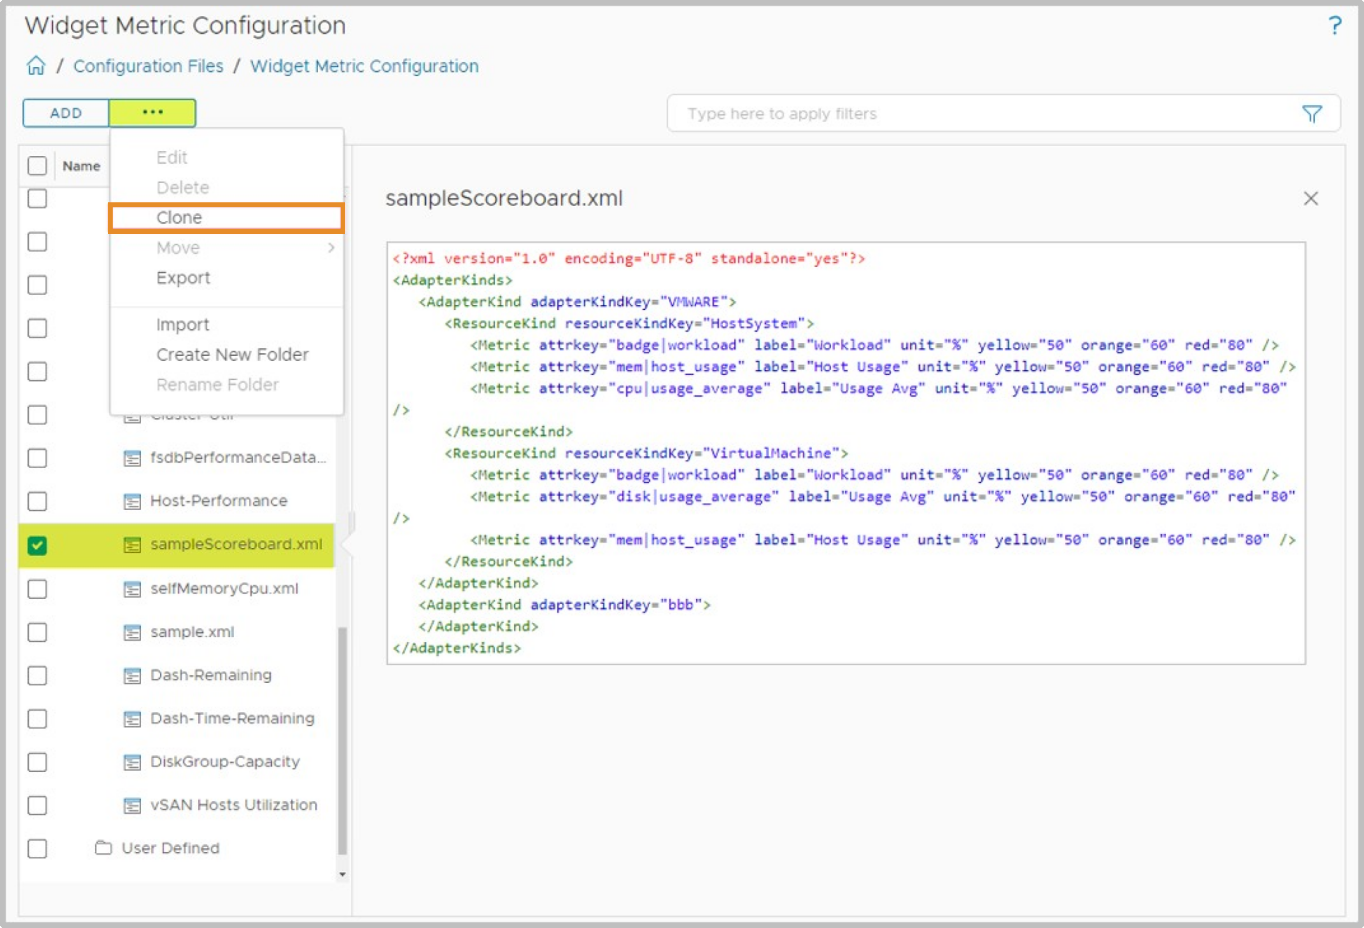
Creating a Metric Configuration File
You create a metric configuration file by using the contents of the sample XML files.
The following example shows how to create the metric configuration file:
Open Infrastructure Operations > Configurations > Widget Metric Configuration.
Expand System Defined.
Select sampleScoreboard.xml and copy its contents.
Create a configuration file.
Paste the contents of sampleScoreboard.xml and edit the required metrics.
Notes:
TalkTrack:
Creating a metric configuration file involves using existing sample XML files as a starting point. This provides a blueprint for the structure and content needed. Here is a step-by-step example for creating one. First, navigate to the correct location within the interface: Infrastructure Operations, then Configurations, and finally Widget Metric Configuration. Next, expand the "System Defined" section. This will reveal a list of pre-existing configuration files. From this list, select "sampleScorecard.xml" and make a copy of its contents. This copied content will form the basis of the new custom file. Now, it is time to create the new configuration file. Provide a suitable name for the new file. Then, paste the copied contents of "sampleScorecard.xml" into this new file. After pasting, edit the necessary metrics to align with specific requirements. After the blueprint from the sample XML is copied, the next crucial step is to edit the metrics and properties within the new file. These adjustments should align with specific data requirements. The configuration file also offers the ability to customize the visual presentation, or the look and feel, of the dashboard. This includes defining labels, units, and critical thresholds such as yellow, orange, and red indicators. For example, a metric attribute key could be defined for "CPU Demand" with units, and color thresholds set for specific values.
<End>
Copy the contents of a sample XML file to your new metric configuration file. After you get the blueprint of the XML file from the copied content, edit the metrics and properties according to your requirements. The configuration XML file can also be used to customize the look-and-feel properties of your dashboard. These properties include labels, units, and the yellow, orange, and red thresholds. For example: < Metric attrkey="cpu|demandPct" label="CPU Demand" unit="%" yellow="50" orange="70" red="85" / >

Slide 22
Review of Learner Objectives
Describe the functions of dashboards
Build a custom dashboard
Configure widget interactions
Use metric configuration files

Slide 23
Managing Dashboards

Slide 24
Learner Objectives
Configure dashboard sharing options
Manage dashboards

Slide 25
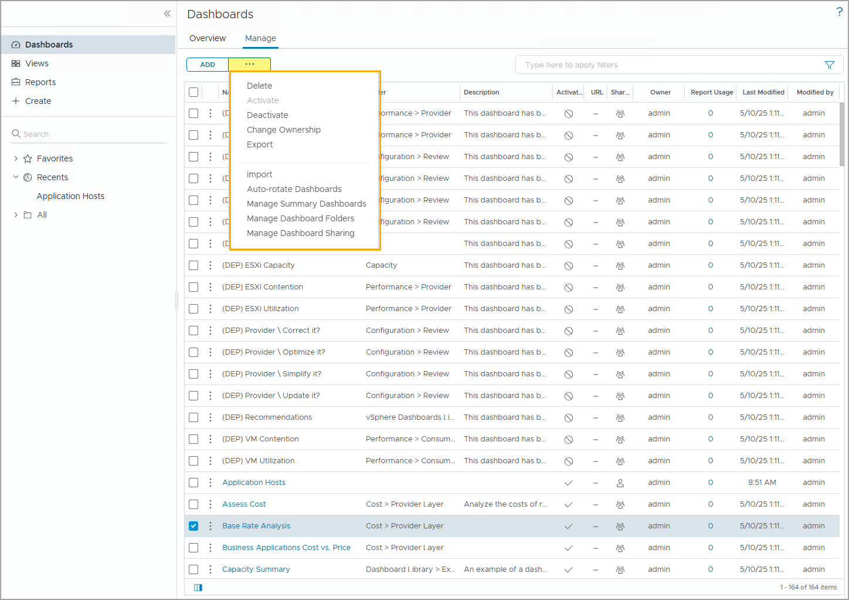
Dashboard Management Options
To manage dashboards in your VCF Operations console, you must first navigate to Infrastructure Operations > Dashboards & Reports > Dashboards > Manage and click the ellipsis icon.
You can access the following dashboard management options:
Delete
Activate
Deactivate
Change Ownership
Export
Import
Auto-Rotate Dashboards
Manage Summary Dashboards
Manage Dashboard Folders
Manage Dashboard Sharing
Notes:
TalkTrack:
Managing dashboards within the VCF Operations Console involves a specific navigation path. First, locate "Infrastructure Operations", then proceed to "Dashboards & Reports", followed by "Dashboards", and finally "Manage". From there, select the three dots (the manage icon) to access the dashboard management options. Several key management options are available. These include the ability to delete a selected dashboard. Dashboards can also be activated. This action makes the collected metrics and data visible on the dashboard. Conversely, dashboards can be deactivated. This effectively hides them from view. Another important option is changing ownership. This allows for the transfer of a selected dashboard to a different user account. Dashboards can be exported. This is useful for utilizing a dashboard in another VCF operations environment. Similarly, dashboards can be imported. This allows for previously exported dashboards to be brought into the current VCF operations environment. The "Auto-Rotate Dashboards" feature configures a dashboard to automatically switch to another dashboard after a predefined time interval. This is useful for displaying a rotating set of information. There is also an option to manage summary dashboards. This allows for changes to the summary tab of a dashboard to include specific information as needed. Finally, dashboards can be organized into folders. This provides a way to manage and categorize dashboards in a structured manner. This also allows for sharing selected dashboards using various sharing options.
<End>
Delete: deletes the selected dashboard(s).
Activate: activates the selected dashboard(s).
Activated dashboards can display the collected metrics and data.
Deactivate: deactivates the selected dashboard(s).
Change Ownership: transfers the selected dashboard(s) to another user account.
Export: exports the selected dashboard(s) so they can be used in another VCF Operations environment.
Import: imports previously exported dashboards to this VCF Operations environment.
Auto-Rotate Dashboards: configures how a dashboard can automatically switch to another dashboard after a predefined time interval.
Manage Summary Dashboards: changes the Summary tab with a dashboard to get information specific to your needs.
Manage Dashboard Folders: organizes the dashboards into created dashboard folders in a way that is meaningful to you.
Manage Dashboard Sharing: shares the selected dashboard(s) using various sharing options.

Slide 26
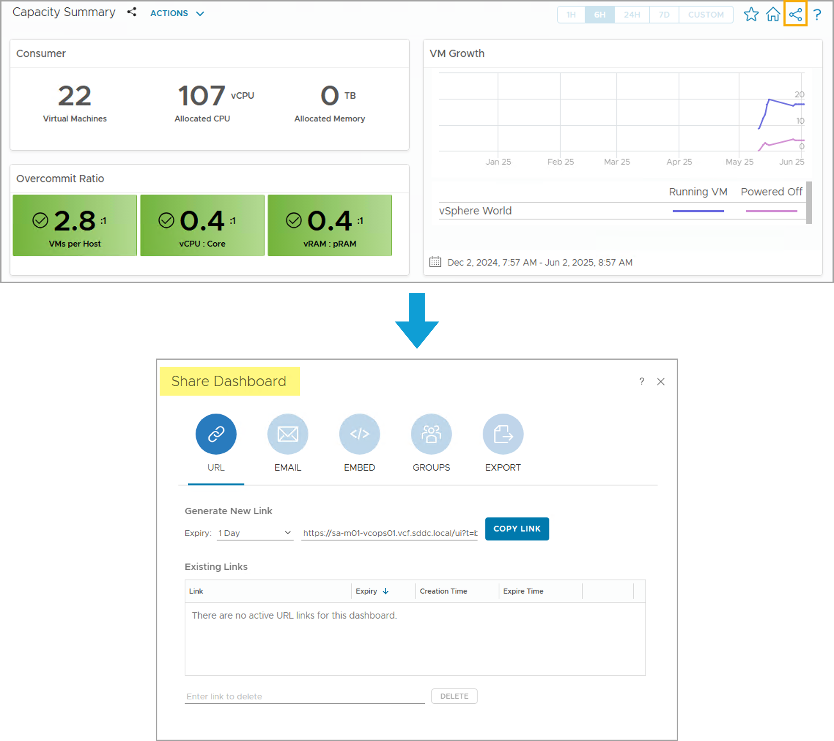
Understanding Dashboard Sharing Options
Both custom and predefined dashboards can be shared with different users from the Dashboards page.
Select an existing dashboard and click the Share Dashboard icon in the top-right corner.
Notes:
TalkTrack:
Dashboards, whether they are custom-built or predefined, can be easily shared with other users directly from the dashboards page. This facilitates collaboration and information dissemination. To initiate the sharing process, first select the desired dashboard. Then, locate and click the "Share Dashboard" icon, which is typically found in the top-right corner of the interface. Once the sharing options appear, several methods are available. A unique URL can be generated. This URL allows direct access to the dashboard. Alternatively, the dashboard can be shared via email. This sends a link to the dashboard directly to specified recipients. For integration into other platforms, an embed code can be generated. This code allows the dashboard to be embedded within internal web pages, such as a Confluence page or other internal official webpages. Dashboards can also be shared with predefined user groups. This provides an efficient way to distribute information to relevant teams or departments. Finally, there is an option to export the dashboard, which can then be imported into other environments or shared offline. These various sharing options provide flexibility. They allow the user to disseminate valuable dashboard insights effectively, whether through direct links, email, embedding in web pages, or sharing with specific groups.
<End>
You can share predefined or custom dashboards using URLs, emails, and by copying the code to embed the dashboard into Confluence or other internal official webpages.

Slide 27
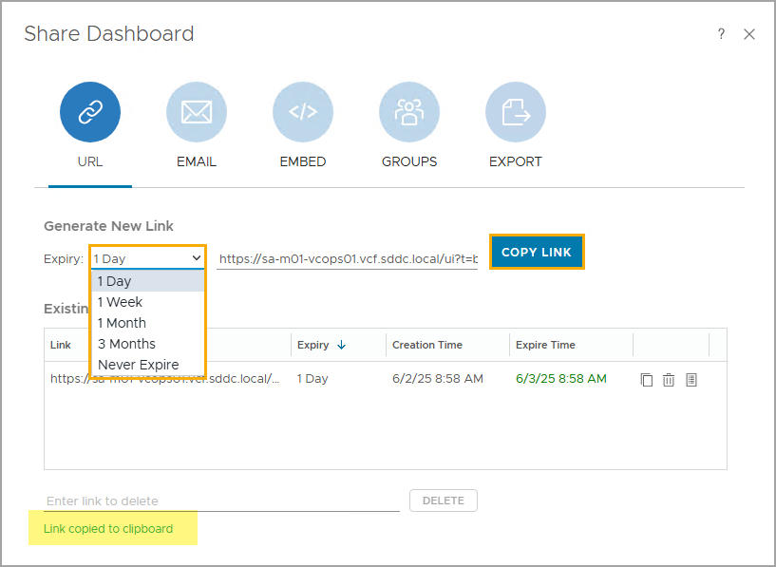
Sharing Dashboards Using URL
You can create a URL for the selected dashboard.
Click Copy Link to copy the link to the clipboard.
Link Expiry can be set to 1 Day, 1 Week, 1 Month, 3 Months, or Never Expire.
Notes:
TalkTrack:
One method for sharing dashboards involves generating a concise URL. This URL provides direct access to the selected dashboard. To obtain the URL, simply click the copy link button. This action will place the link onto the clipboard, ready for pasting. The generated link includes an expiry setting. This allows for control over how long the link remains active. The expiry can be set to one day, one week, one month, three months, or even configured to never expire. It is possible to manage these links after creation. From the existing links pane, a link can be permanently deleted. Additionally, for security and tracking, there is an option to check usage. This allows for the identification of who has accessed the dashboard through that specific link. For instance, if a link is set to expire in one day, it will cease to function exactly one day after its creation.
<End>
You can delete the link and remove access from within the Existing Links pane. You can also click the Check Usage icon to identify who has been accessing the dashboard. In this example, the link will expire 1 day after it was created.

Slide 28
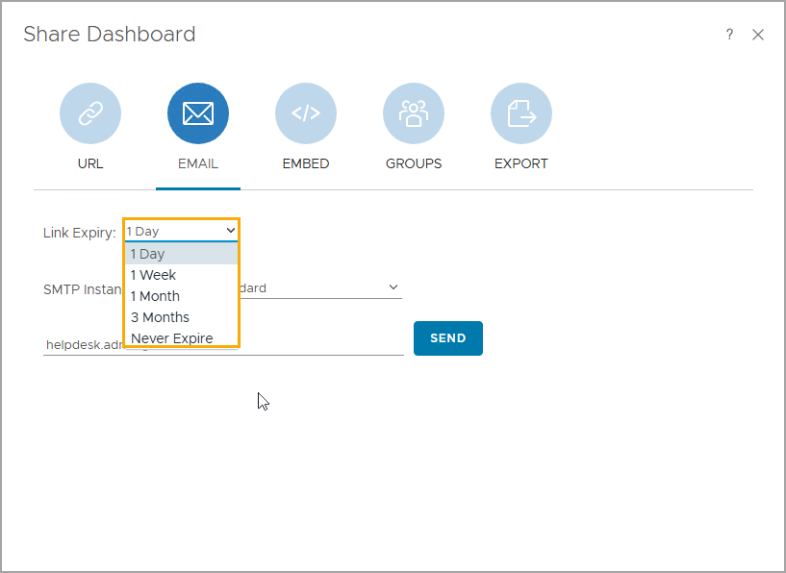
Sharing Dashboards Using Email
Built-in or custom dashboards can be shared through email with different users. Link Expiry can be set to 1 Day, 1 Week, 1 Month, 3 Months, or Never Expire.
Notes:
TalkTrack:
Dashboards, whether they are built-in or custom, can be readily shared with different users via email. This method provides a direct way to distribute dashboard access. Similar to URL sharing, the email link includes an expiry setting. This allows for control over the link's active duration. Options include one day, one week, one month, three months, or the link can be set to never expire. To utilize this email sharing functionality, a prerequisite is to have an SMTP configuration set up. This ensures the system can send out the emails. Once configured, a dashboard can be emailed to anyone.
<End>
You can email a dashboard to anyone using EMAIL.
Note: To use email, you must set up an SMTP configuration.

Slide 29
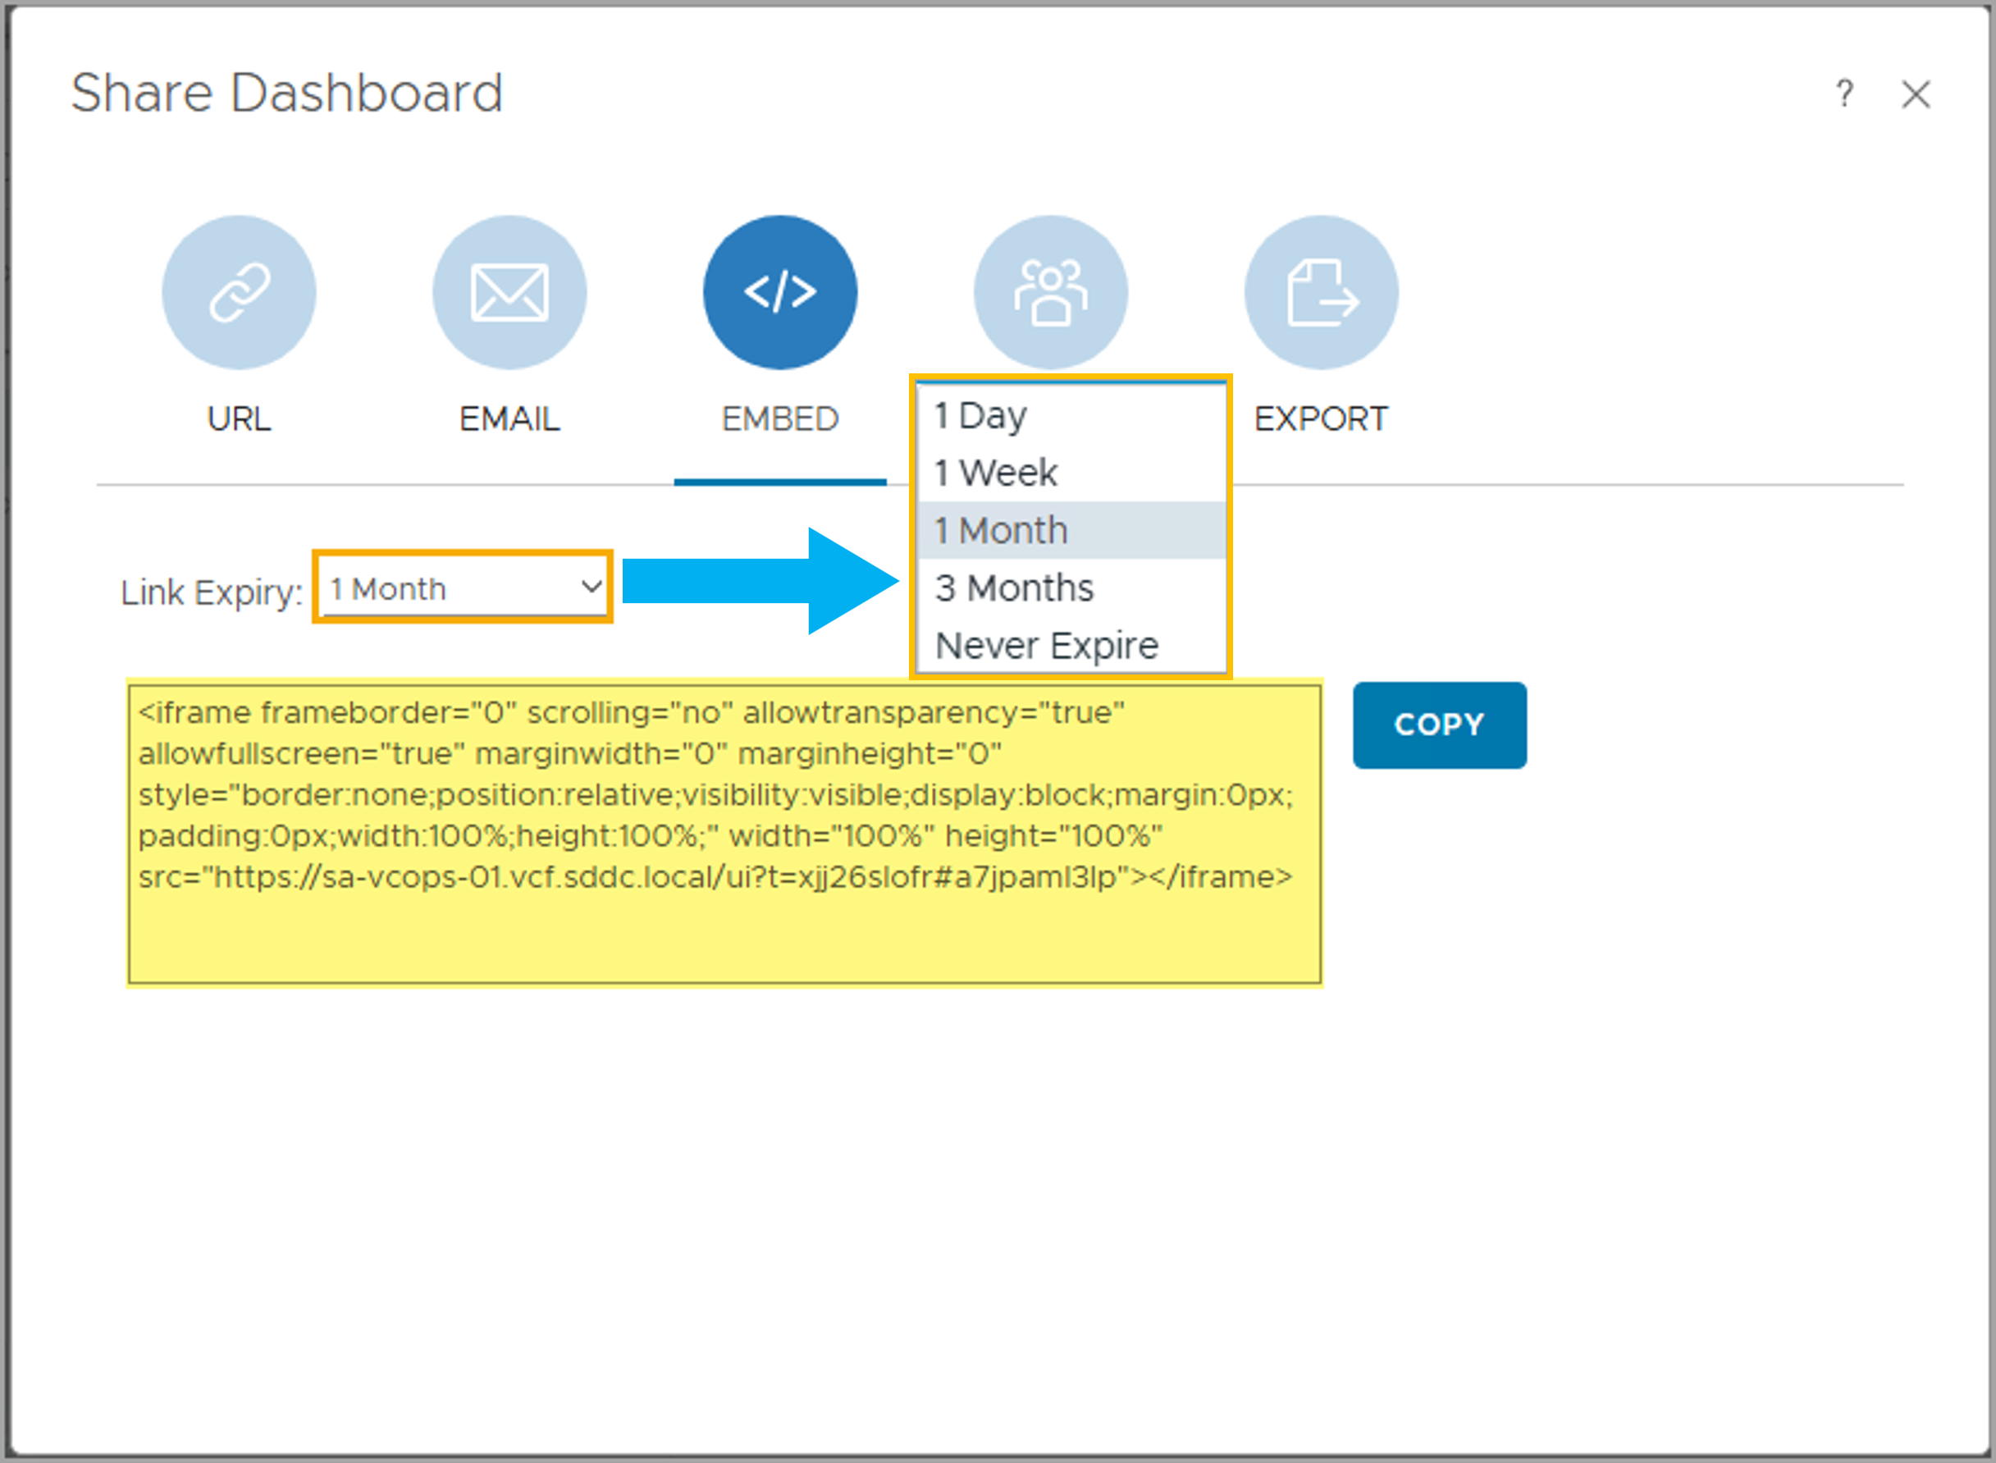
Sharing Dashboards Using Embed
Built-in or custom dashboards can be shared with different users by copying the HTML code to another web page. Link Expiry can be set to 1 Day, 1 Week, 1 Month, 3 Months, or Never Expire.
Notes:
TalkTrack:
Dashboards, whether predefined or custom-built, can be seamlessly integrated into other webpages. This is achieved by copying and embedding the provided HTML code. The embedded link comes with an expiry option. This allows control over how long the dashboard remains accessible through the embedded code. Expiry durations include one day, one week, one month, three months, or the option to never expire. To embed a dashboard, simply select the embed option. Then, copy the generated HTML code. This code can then be pasted directly into the desired webpage. This provides a straightforward way to display the dashboard's contents within a different web environment. The embed option makes it easy to share dynamic dashboard content with a wider audience by incorporating it into existing web infrastructure.
<End>
Embed a dashboard into a webpage with HTML code. Using the EMBED option, you can easily embed a dashboard into another webpage by copying the HTML code and setting the duration you want the dashboard to be available for sharing.

Slide 30
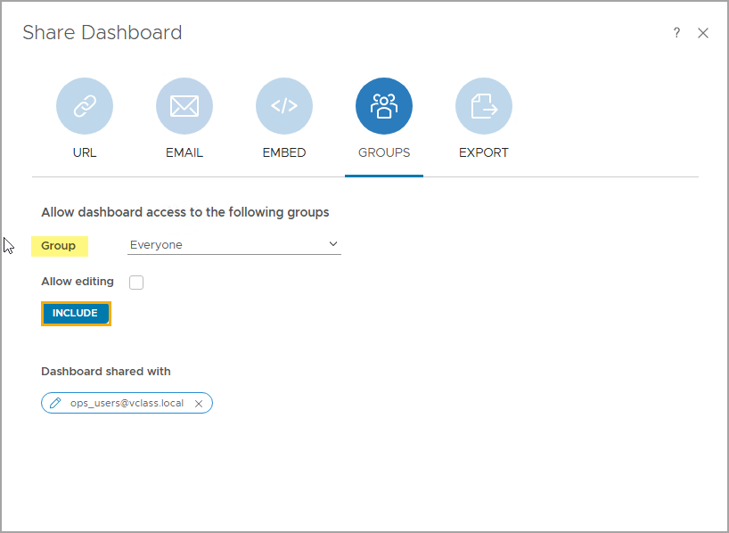
Sharing Dashboards Using Group Sharing
Predefined or custom dashboards can be shared with different authentication groups.
Select the group to which you want to grant dashboard access from the drop-down menu and click INCLUDE.
To share dashboard edit privileges with the group, select the Allow editing checkbox.
Notes:
TalkTrack:
Dashboards, whether predefined or custom-built, can be effectively shared with various authentication groups. This feature streamlines access management. To grant access, first select the desired group from the available drop-down menu. After selecting the group, click "Include" to confirm the access grant. For further control over sharing privileges, the "Allow editing" checkbox can be selected. This grants the group permission to make modifications to the dashboard. The group sharing option is versatile, supporting both internal and external authentication groups. Internal groups are those created directly within the VCF Operations environment. External groups, on the other hand, include user groups imported through LDAP, such as those from an Active Directory user domain. This flexibility ensures that dashboards can be shared securely and efficiently with all relevant stakeholders.
<End>
You can share your dashboard with authentication groups that have been set up within your VCF Operations environment.
The Group sharing option supports sharing with both Internal and External groups. Internal groups include the groups created or imported internally to your VCF Operations environment, such as the AD user groups imported through LDAP.

Slide 31
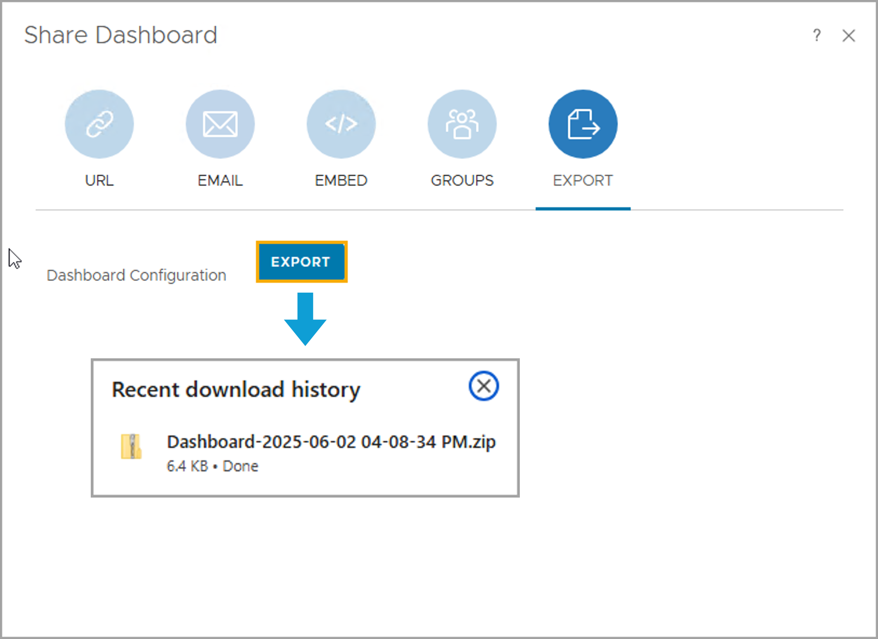
Sharing Dashboards Using Export
Predefined or custom dashboards can be exported to different VCF Operations environments.
Click EXPORT to generate a ZIP file containing the dashboard. The ZIP file can be unzipped to an XML file, which can be imported to any other VCF Operations environment.
The Export sharing option can be useful when you need to move complex dashboards between VCF Operations environments, for example, moving a multi-interaction inventory dashboard from your testing environment to your production environment.
Notes:
TalkTrack:
Dashboards, whether predefined or custom, can be exported. This functionality allows for their transfer to different VCF Operations environments. To export a dashboard, click "Go" to generate a ZIP file. This ZIP file contains the dashboard's configuration. The ZIP file can then be unzipped to reveal an XML file. This XML file is the core of the dashboard and can subsequently be imported into any other VCF Operations environment. The export sharing option is particularly advantageous for managing complex dashboards across various environments. For example, it simplifies the process of moving a multi-interaction inventory dashboard from a testing environment to a production environment. This ensures consistency and reduces manual configuration efforts when deploying dashboards in different operational contexts.
<End>

Slide 32
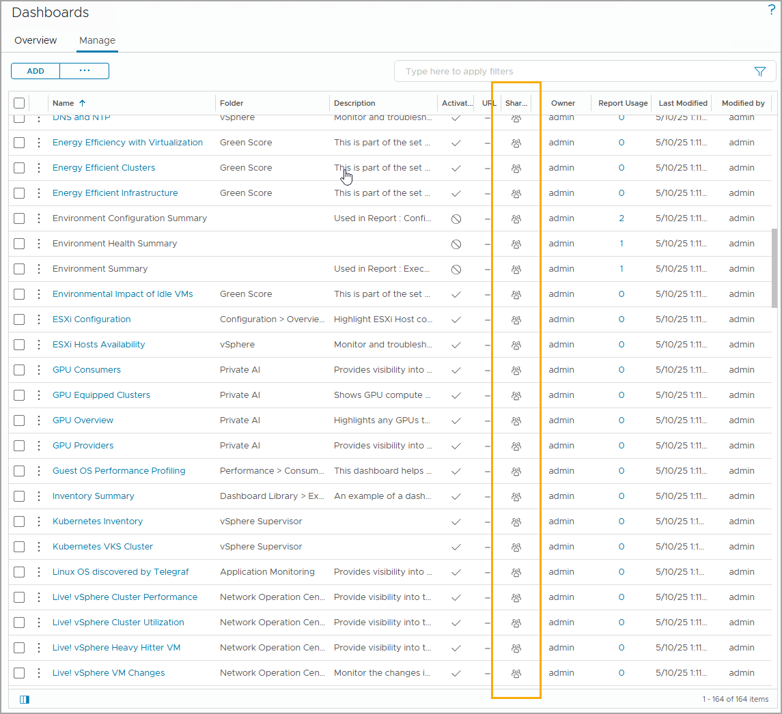
Understanding Dashboard Ownerships
When you share a dashboard, it becomes available to all the users in the user group that you select for sharing.
When a dashboard is shared, only the owner of the dashboard can edit it.
The Shared Dashboards column indicates whether a dashboard is shared or not shared.
Notes:
TalkTrack:
Understanding dashboard ownership is crucial when sharing. When a dashboard is shared, it becomes accessible to all users within the specific user group selected for sharing. It is important to note that even after a dashboard is shared, only the original owner retains the ability to edit it. This ensures control over the dashboard's design and configuration. The "Shared Dashboards" column provides a quick visual indicator. This column shows whether a dashboard has been shared or if it remains private. Within this column, an icon indicates the sharing status. This icon signifies whether the dashboard is shared with an individual user or an entire group, providing immediate clarity on its accessibility.
<End>
The icon in the Shared column indicates whether the dashboard is shared with an individual user or an entire group.

Slide 33
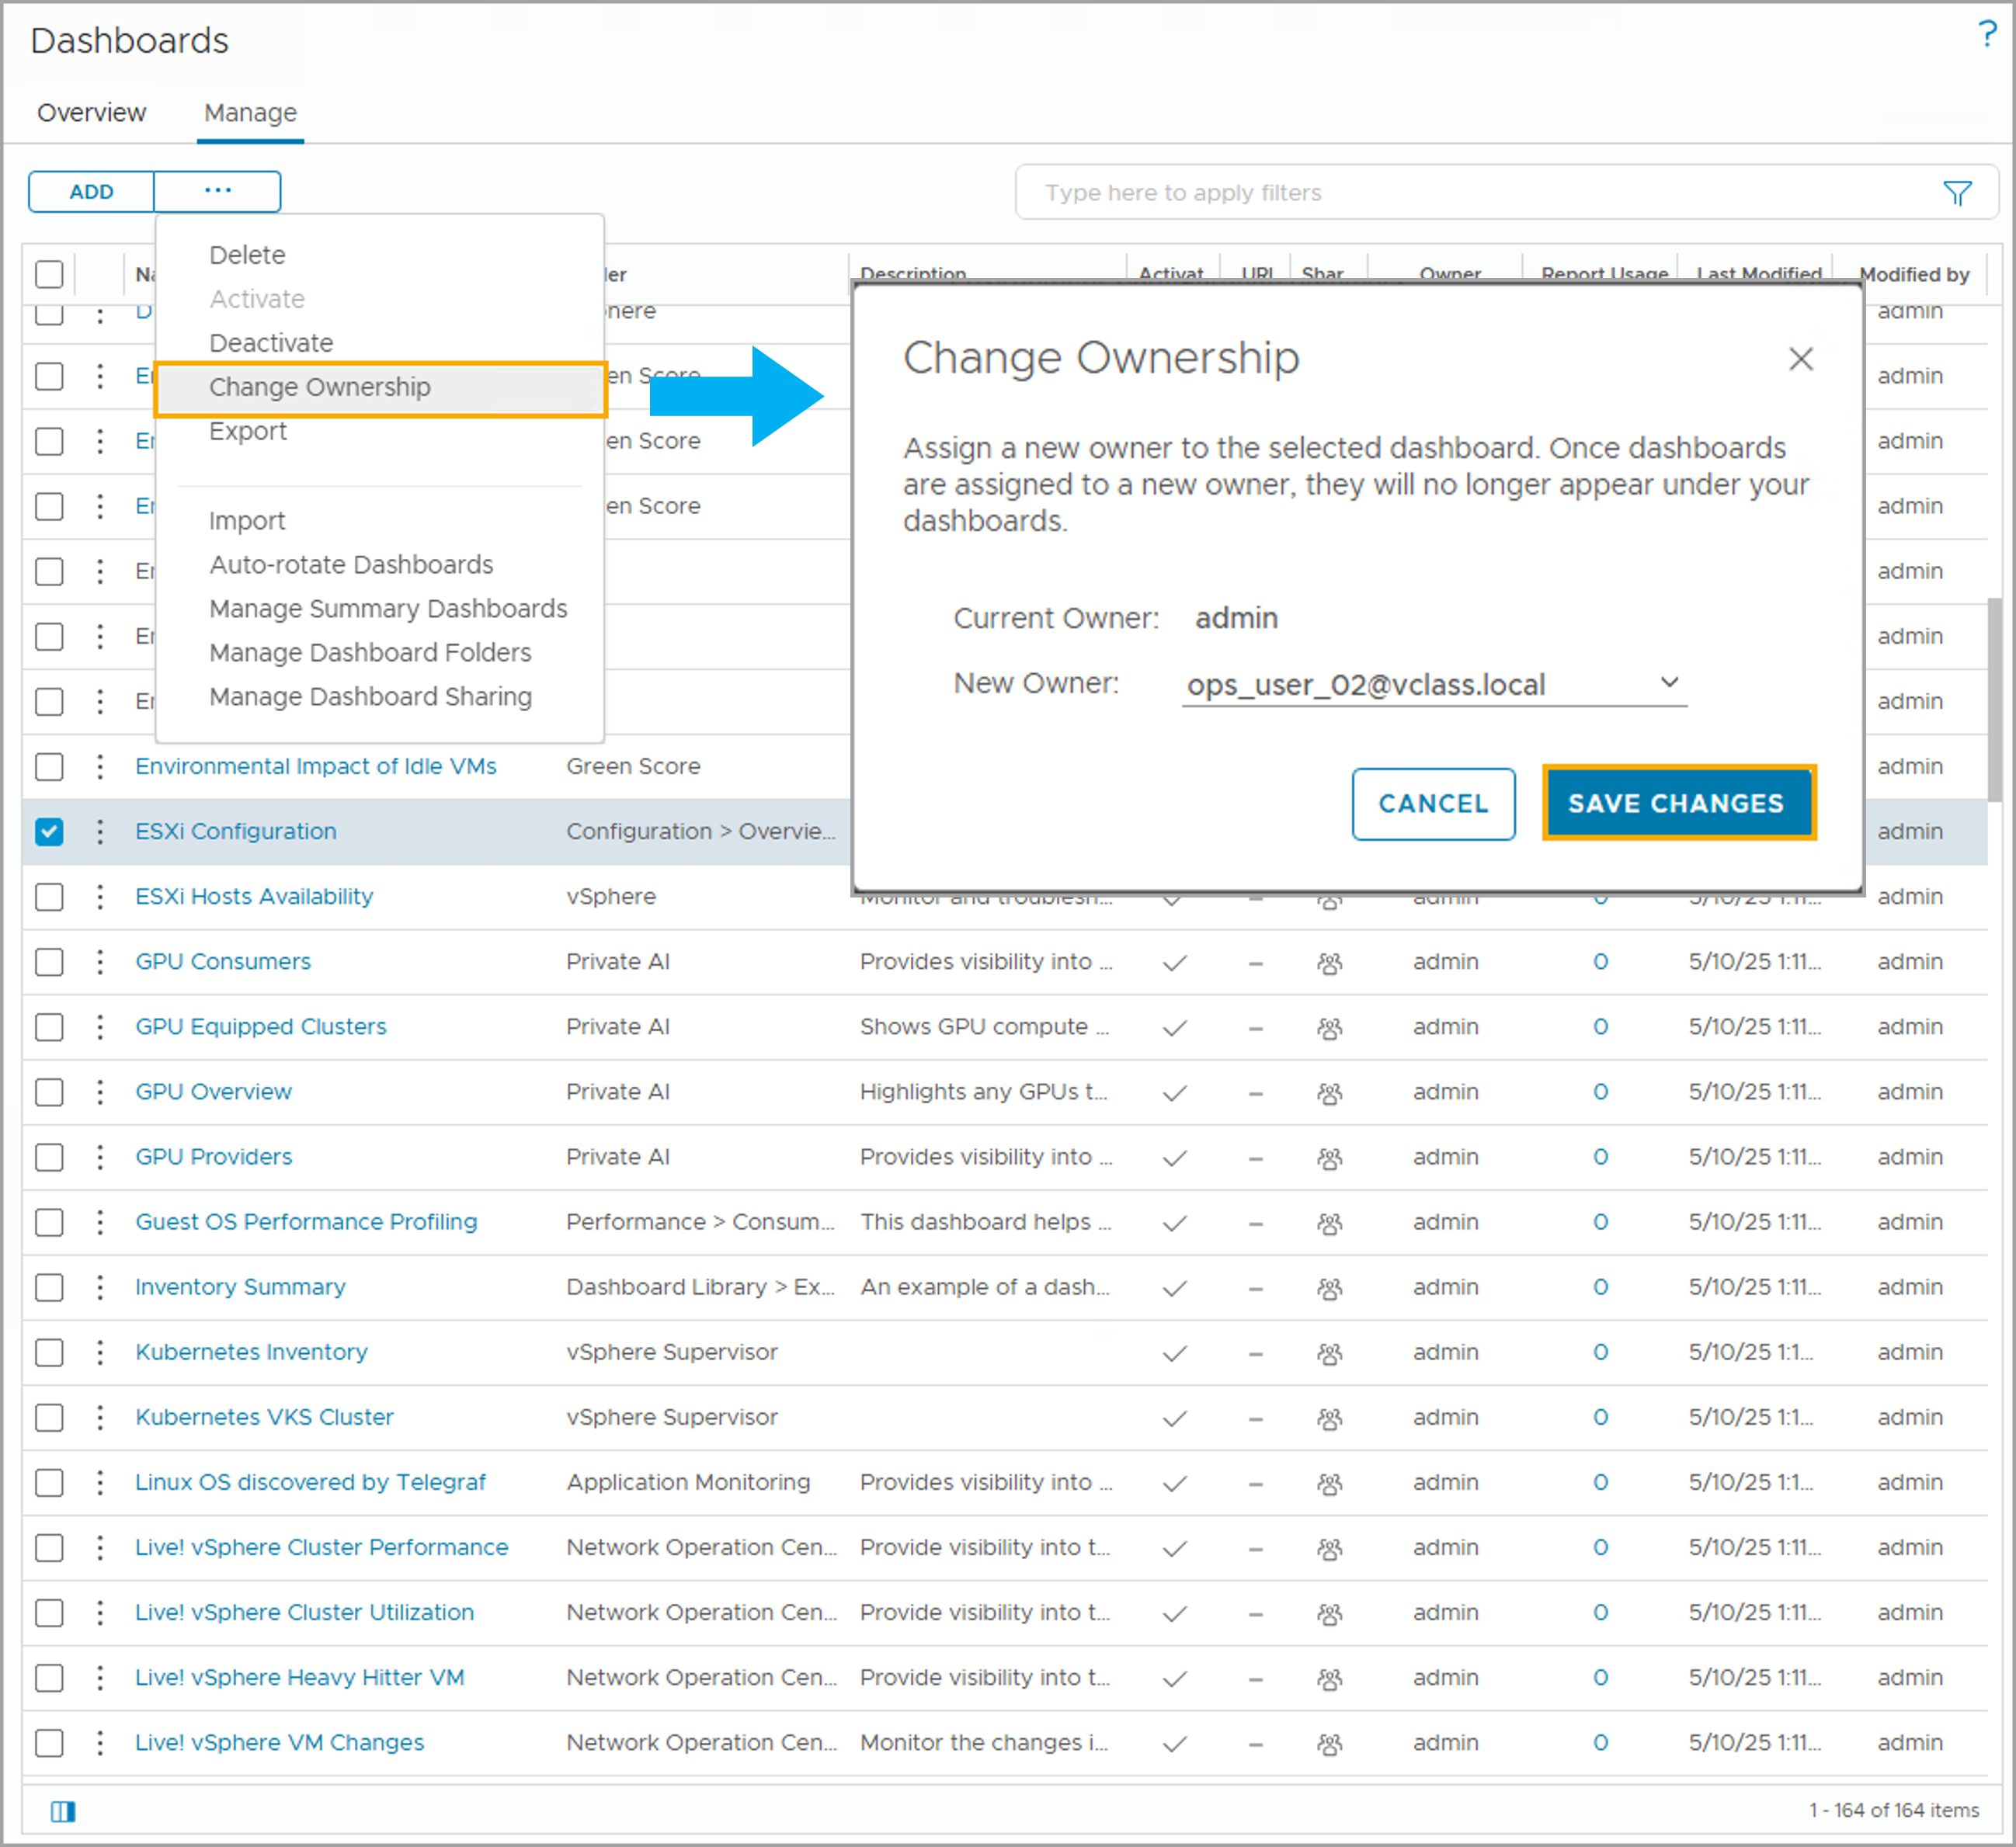
Dashboard Ownership Transfers
Dashboards can be transferred to different users. After the dashboard is transferred, the dashboard disappears from the current owner's login account.
Select the dashboard from the Dashboard list and select Change Ownership from the dashboard management menu.
Notes:
TalkTrack:
Dashboards can be transferred between different users. Once a dashboard's ownership is transferred, it will no longer appear in the previous owner's login account. To transfer ownership, first select the desired dashboard from the dashboard list. Then, from the dashboard management menu, choose the "Change Ownership" option. A new owner can be assigned to the selected dashboard. Once this assignment is made, the dashboard will no longer be visible to the former owner. Transferring a dashboard is particularly useful when a user account is deleted from the environment. The administrator can take over the ownership of the deleted user's dashboards or transfer them to another user account. When a dashboard that was previously shared with user groups is transferred, all information about the shared user groups and group hierarchy is retained.
<End>
Transferring a dashboard is useful when a VCF Operations user is deleted. The user administrator can take over the ownership or transfer the ownership of the deleted user’s dashboards to another user account. When you transfer a dashboard that was previously shared with user groups, information about the shared user groups and group hierarchy is retained.

Slide 34
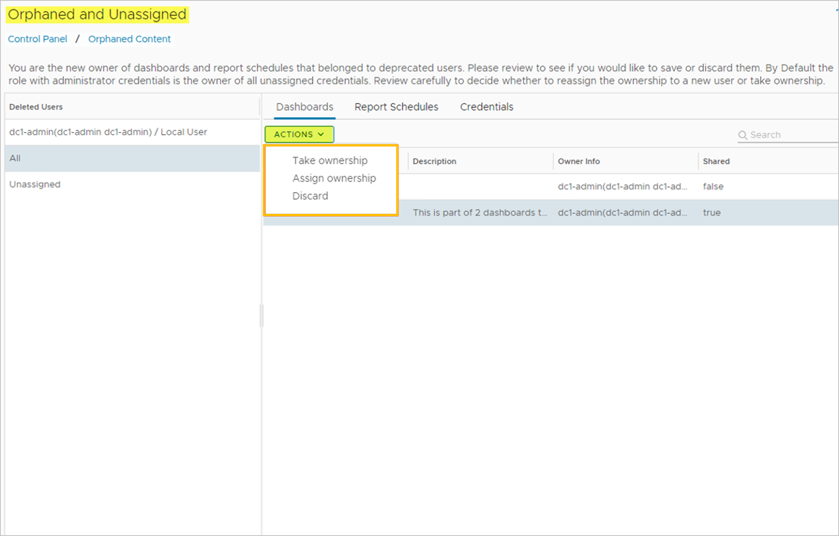
Managing Orphaned and Unassigned Content
When the user who created the dashboards, report schedules, and credentials created are deleted, or when the dashboards, report schedules, and credentials are unassigned, this content becomes Orphaned or Unassigned in VCF Operations.
To access the Orphaned and Unassigned content, navigate to Administration > Control Panel > Orphaned Content.
As an admin user, you can take ownership, assign ownership, discard orphaned dashboards, or report schedules and credentials from the ACTIONS menu.
Notes:
TalkTrack:
In a VCF Operations environment, content can become orphaned or unassigned under specific circumstances. This occurs when the user who created dashboards, report schedules, and credentials is deleted. It also happens if these items (dashboards, report schedules, and credentials) become unassigned. To access and manage this orphaned and unassigned content, navigate through the administrative interface. The path is Administration, then Control Panel, and finally Orphaned Content. As an administrative user, there are several actions available for managing this content. Ownership of orphaned dashboards, report schedules, or credentials can be taken over. Additionally, ownership can be assigned to a new user. The content can also be permanently discarded. These options are accessible from the Actions menu. Regarding the available options for dealing with orphaned content, one action is to take ownership. This allows the administrator to assume control of a selected dashboard, report schedule, or credential. Another option is to assign ownership. This involves assigning a new owner to the selected dashboards or report schedules. Finally, there is the option to discard. This permanently deletes the dashboard, report schedule, and unassigned credentials. It is important to note that an active credential, even if unassigned, cannot be deleted if it is still being used by an adapter instance.
<End>
The following options are available for dealing with orphaned and unassigned content:
Take Ownership: Take ownership of the selected dashboard, report schedule, or credential.
Assign Ownership: Assign a new owner to the selected dashboards or report schedules.
Discard: Permanently delete the dashboard, report schedule, and unassigned credentials that are not in use in any adapter instance. You cannot delete an active credential that is being used by an adapter instance even if it is unassigned.

Slide 35
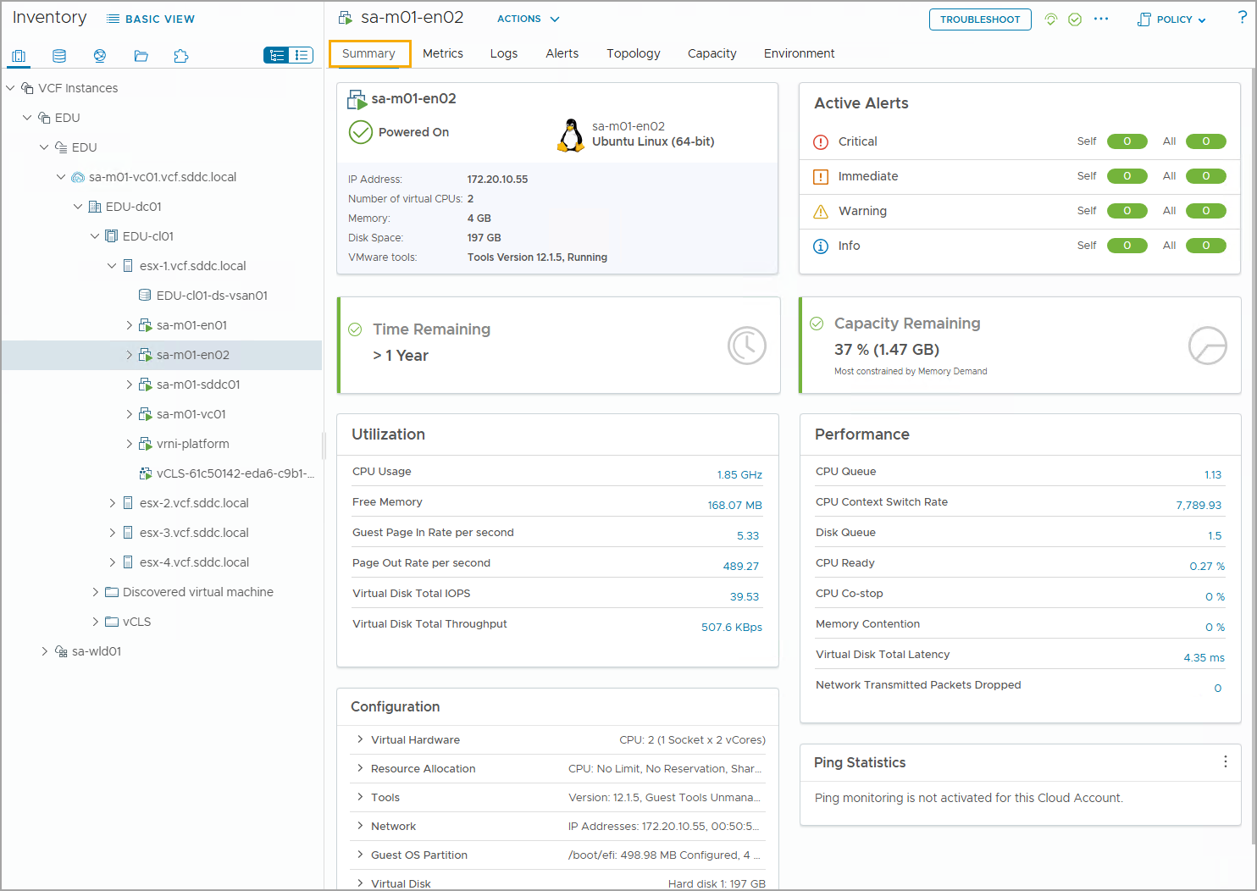
Understanding the Summary Tab
In the VCF Operations console, you can view the summary of an object by navigating to Inventory and selecting the object.
By default, the Summary tab provides an overview of the health, risk, and efficiency states of the selected object, group, or application.
You can change the Summary tab to a different dashboard to get information specific to your needs.
Notes:
TalkTrack:
In the VCF Operations console, the summary tab provides a high-level overview of an object's health, risk, and efficiency status. This view is accessed by navigating to the inventory and selecting a specific object. By default, the summary tab presents an overview of the selected object, group, or application. It consolidates key information into a single, easily digestible view. The summary tab can be customized. It is possible to change the default summary to a different dashboard, allowing for the presentation of information tailored to specific needs. This flexibility ensures that the most relevant data is always at hand. Consider an example: to change the dashboard on an object's summary tab, one can associate a different dashboard with the object type. For a virtual machine object, the summary tab could display either vSphere metrics or the application's performance dashboard, depending on what information is most pertinent to the task at hand. This customization capability empowers users to create highly effective and focused operational views.
<End>
To change the dashboard on an object’s Summary tab, you associate a different dashboard with the object type. For example, the Summary tab for the Virtual Machine object type can display either vSphere metrics or the application performance dashboard.

Slide 36
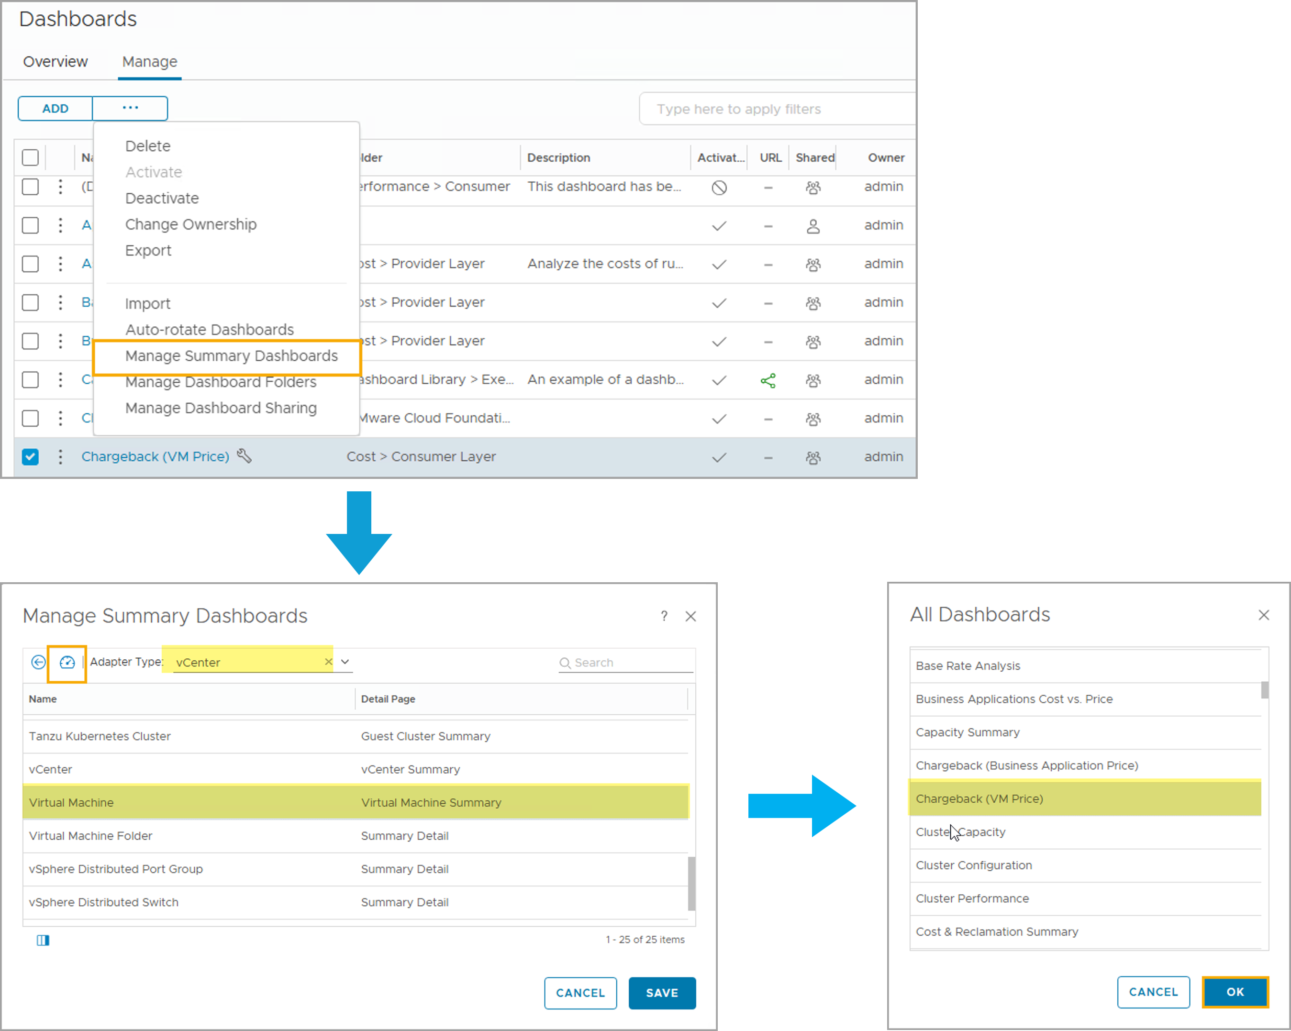
Changing the Summary Tab
In the Manage Summary Dashboards dialog box, you can assign a dashboard to the object type selected.
To assign a dashboard to an object type:
Select Manage Summary Dashboards from the dashboard management menu.
Select the adapter type and object and click the Assign a dashboard icon.
Select a dashboard from the list of dashboards and click OK.
Click Save.
Notes:
TalkTrack:
Modifying the summary tab allows for greater customization of information presented for specific object types. The process begins in the Manage Summary Dashboards dialog box. Here, a dashboard can be assigned to a particular object type. To assign a dashboard to an object type, the first step is to select "Manage Summary Dashboards" from the dashboard management menu. This action opens the necessary configuration window. Next, the relevant adapter type and object should be selected. Once these are chosen, click the "Assign a dashboard" icon. This prompts the selection of the dashboard itself. From the list of available dashboards, select the one desired for the summary tab. After making the selection, confirm by clicking "OK". The final step in this process is to save the changes. This ensures the newly assigned dashboard is applied to the summary tab for the chosen object type. For example, if a specific dashboard is associated with the Virtual Machine object type, it will then appear on the summary tab whenever any object of that type is selected. After selecting a new dashboard, remember to save the changes within the Manage Summary Dashboards dialog box to ensure the new configuration takes effect.
<End>
The dashboard that you associated with the Virtual Machine object type appears on the Summary tab for any object of that type. After you select the new dashboard, click SAVE in the Manage Summary Dashboards dialog box.

Slide 37
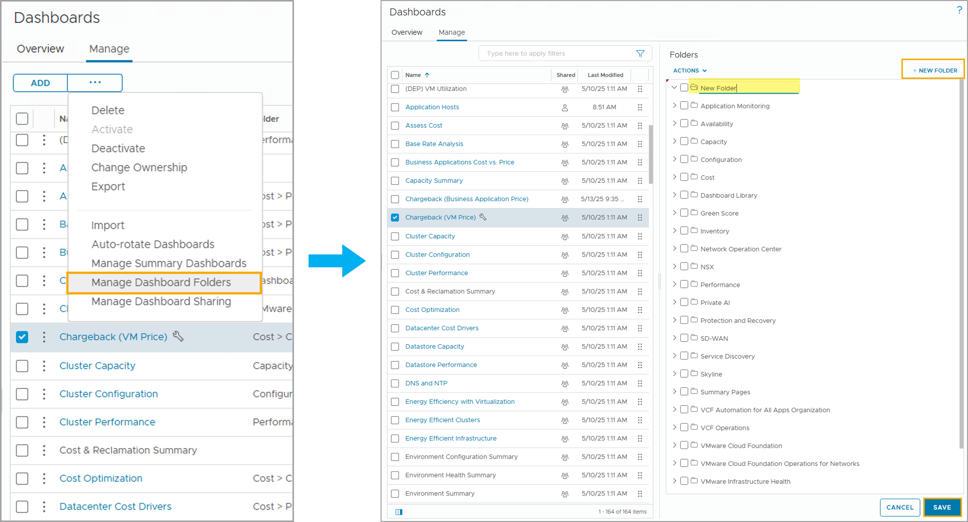
Managing Dashboard Folders
You can create dashboard folders to group the dashboards in a way that is meaningful to you.
To create a dashboard folder, click NEW FOLDER in the Folders pane and enter the name of the folder.
You can add a dashboard to the folder by dragging the dashboard to the folder.
Notes:
TalkTrack:
Managing dashboard folders provides a powerful way to organize dashboards. These folders allow for grouping dashboards in a manner that is most meaningful to the user, enhancing navigation and accessibility. To create a new dashboard folder, first locate the "Folders" pane. Within this pane, click on "NEW FOLDER". After clicking, simply enter the desired name for the new folder. Once a folder is created, dashboards can be added to it with ease. This is done by dragging the chosen dashboard directly into the folder. This drag-and-drop functionality streamlines the organization process. After a folder is created and dashboards are added, all the dashboards within that folder become accessible. They can be found and opened directly from the menu on the Dashboards Home page, providing a centralized and organized access point.
<End>
When you create a folder, all the dashboards added to the folder can be accessed from the menu on the dashboards Home page.

Slide 38
Lab: Creating Dashboards and Configuring Widgets
Create a vSphere dashboard and configure widgets:
Create the vSphere Metrics Dashboard
Add Widgets to the vSphere Metrics Dashboard
Configure a Widget Interaction in the vSphere Metrics Dashboard

Slide 39
Review of Learner Objectives
Configure dashboard sharing options
Manage dashboards

